Slide 1
State of Auditing in 2014
Robert Mitchell, MBA, CPA
Director, Strategic Planning and Performance
US Postal Service Office of Inspector General
November 12, 2014

Slide 2
US Postal Service at a Glance
$1.3 Trillion | The U.S. Postal Service is the core of a more than $1.3 trillion mailing industry that employs more than 8 million people
40% | Of the world’s mail volume is handled by the Postal Service
20.1 billion | Stamps were sold in 2013
1.2 billion | Miles driven each year by letter carriers and truck drivers.
1.1 billion | Annual visitors to usps.com; averaging 3.6 million visits per day
$67.3 Billion | Annual revenue
200 miles | Of conveyors within postal processing facilities
35,434 | 35,434 retail facilities - larger than McDonald’s, Starbucks, and Walmart combined, domestically.
33 petabytes | Of storage capacity equivalent to playing 83,000 years of songs on an MP3 — no repeats.
Notes:
Source: Postal Facts 2014

Slide 3
State of Auditing in 2014
Themes:
Business environment is changing
Perceptions of Audit’s value are diverging
Expectations of Audit are changing, and Audit is struggling to meet expectations
Is Continuous Assurance the future?

Slide 4
State of Auditing in 2014
Theme 1:
Business environment is changing
Technology is changing business in a major way, and the pace of change is accelerating.

Slide 5
Notes:
Source: New Horizons – How Information Technology Continues to Impact the Way We Do Business, Harald Nehring, VP Technology Marketing, SAP AG, SAP Mining and Metals Forum 2012

Slide 6
Notes:
Source: New Horizons – How Information Technology Continues to Impact the Way We Do Business, Harald Nehring, VP Technology Marketing, SAP AG, SAP Mining and Metals Forum 2012

Slide 7
Notes:
Source: New Horizons – How Information Technology Continues to Impact the Way We Do Business, Harald Nehring, VP Technology Marketing, SAP AG, SAP Mining and Metals Forum 2012

Slide 8
Notes:
Source: New Horizons – How Information Technology Continues to Impact the Way We Do Business, Harald Nehring, VP Technology Marketing, SAP AG, SAP Mining and Metals Forum 2012

Slide 9
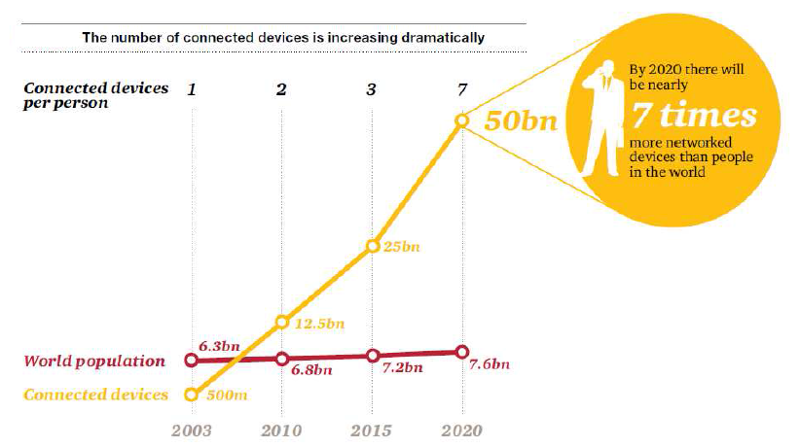
Connected Devices
Notes:
Source: Cited in PWC 17th Annual Global CEO Survey, Jan 2014 [1,344 CEOs in 68 countries], originally from CISCO, The Internet of Things: How the Next Evolution of the Internet is Changing Everything, April 2011.

Slide 10
The Nexus of Forces: People…
want to connect to…
• share experiences
• find answers
• engage with the community
want to be mobile…
• using devices of their choosing
• staying connected with people
• being able to switch easily
between work and non-work
want a seamless
experience to…
• access anything from anywhere
• use multiple devices (and apps),
sometimes simultaneously
• blend work and non-work activities
consume and generate information
• Ubiquitous access to info and apps
• Contextually relevant info to augment
their activities
• Don‘t care how it works, only that it does.
Gartner 2013
Notes:
Source: The Nexus of Forces, Gartner Point of View, by Bart Mellink, June 6, 2013, presented at the BSB 2013 convention:
http://www.bsb.com/2013-bsb-convention-presentations

Slide 11
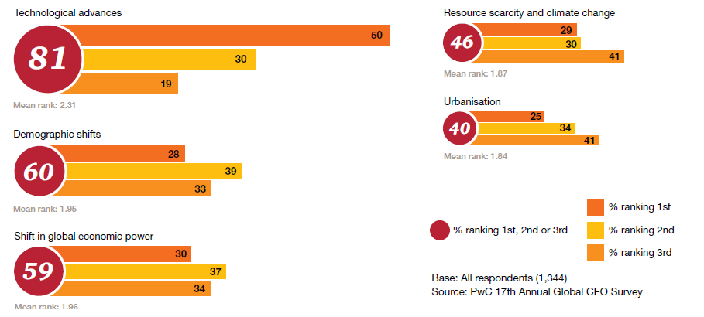
Which of the following global trends do you believe will transform your business the most over the next five years?
PwC 2014
Notes:
Source: PwC, 17th Annual Global CEO Survey, Fit for the Future: Capitalising on Global Trends, Jan 2014.
We’ve conducted 1,344 quantitative interviews with CEOs in 68 countries worldwide, selecting our sample based on the percentage of the total GDP of countries included in the survey, to ensure CEOs’ views are fairly represented across all major countries and regions of the world. The interviews were also spread across a range of industries…. Fifty-four percent of the interviews were conducted by telephone; 38% online; and 8% by post. All quantitative interviews were conducted on a confidential basis. [pg. 38]
Related note:
Over the next 18 months, executives in our survey expect ongoing market changes will affect their firms in three key areas: technological change and related IT risks, increasing regulatory complexity, and rapidly changing customer needs. To address these shifts, companies continue to undergo dramatic transformation, changing their strategies and driving radical internal change: Three out of four survey respondents say their firm has recently undergone a transformation initiative, is doing so, or will in the near future…. these shifts are opening capability gaps in risk management, particularly around data management, business strategy, and technology... To close these capability gaps, executives are focusing on creating a risk-aware culture, developing processes to continuously identify and monitor risks, and conducting more non-financial audits. Companies expect to make significant progress toward greater risk maturity in four areas:
Aligning business and risk strategy
Adopting and applying risk appetite statements
Managing stakeholder expectations
Improving risk monitoring and reporting
[PwC, Risk in Review: Re-evaluating how your company addresses risk, March 2014, pg. 3]

Slide 12
To what extent do you feel that your organization is at risk from each of the following factors over the next 18 months?
PwC 2014
Notes:
Source: PwC, Risk in Review: Re-evaluating how your company addresses risk, March 2014, pgs. 12-13.
Respondents are least satisfied with their abilities around risk forecasting and scenario analysis, and with competencies involving structure and processes – building organizational resilience, building up the risk function and resources, and taking an integrated, corporate-wide approach to risk and compliance.

Slide 13
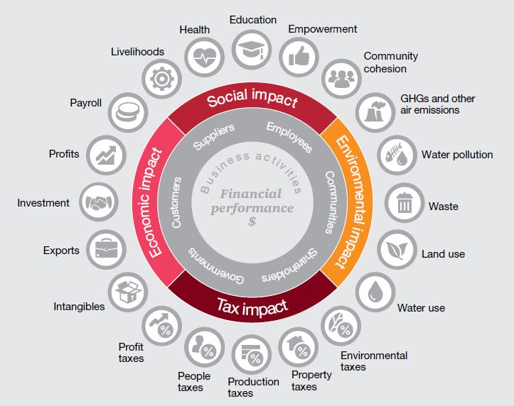
Measuring an organization’s total impact helps to show the best route forward
PwC 2014
Notes:
Source: PwC, 2014 17th Annual Global CEO Survey: Fit for the Future, Capitalizing on Global Trends, pg. 34. This was a survey of 1,344 c-suite interviews between Sept 9 and Dec 6, 2013, from 68 countries.
About a quarter of large companies currently report on their social and environmental impact.
Despite the challenges, quantifying an organization’s footprint in a common business
language has two major benefits. It helps management understand the trade-offs between different strategies and make the best decisions for all its stakeholders. That, in turn, helps the organization earn more trust, more custom and so, more profit.

Slide 14
Change is driving CEOs to…
Rethink the business model
Out innovate competitors
Accelerate globalization
Sustain the change
Photo by Roy Moody
Notes:
Driving CEOs to Rethink the business model, Out innovate competitors, Accelerate globalization, Sustain the change are from:
SAP Strategy and Innovation for the Future, by Dr. Chakib Bouhdary, Executive Vice President, Corporate Strategy and Industry Solutions SAP AG, at SAP Mining and Metals Forum 2012.
Photo by Roy Moody

Slide 15
State of Auditing in 2014
Theme 2:
Perceptions of Audit’s value are diverging

Slide 16
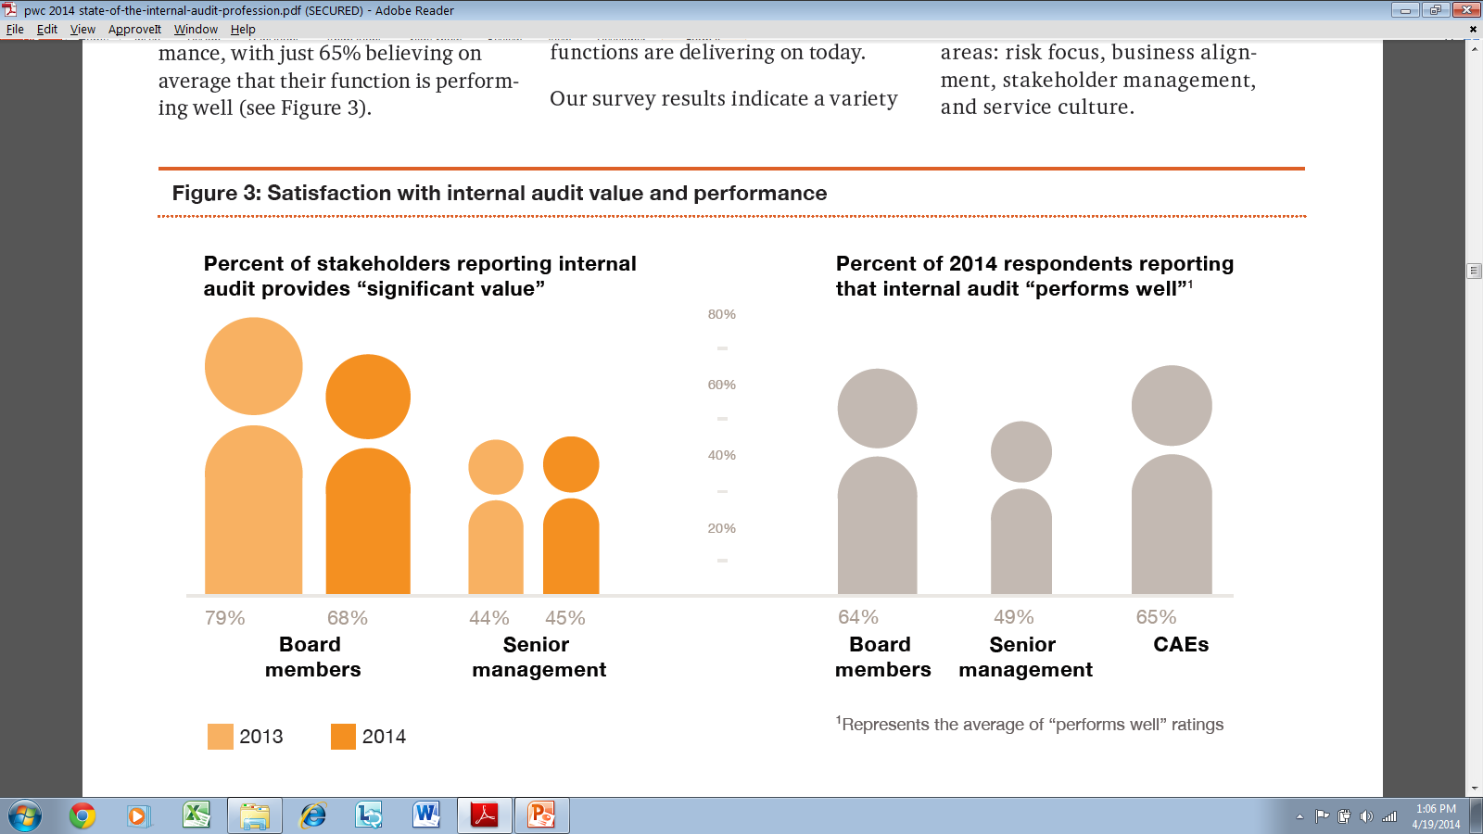
Board members, senior management and chief audit executives (CAEs) perceive Audit differently
PwC 2014
Notes:
Source: PWC, 2014 State of the Internal Audit Profession Study, March 2014, page 7.
An online survey of 1,920 executives from 24 industries in 37 countries, and 1-on-1 interviews with more than 125 stakeholders from North America, Europe, Australia and Asia.

Slide 17
Board members, senior management and CAEs agree on expectations, but differ on how well Audit meets them
Board members (90%), senior management (85%) and CAEs (96%) are aligned on the expectation that internal audit should focus on critical risks and issues facing the company.
But while 83% of CAEs believe they do this well, only 63% of senior management thinks so.
PwC 2014
Notes:
Source: PWC, 2014 State of the Internal Audit Profession Study, March 2014, page 8.
An online survey of 1,920 executives from 24 industries in 37 countries, and 1-on-1 interviews with more than 125 stakeholders from North America, Europe, Australia and Asia.

Slide 18
The top internal audit functions perform at a high level on eight foundational capabilities
More than half (55%) of senior management does not believe internal audit adds significant value to their organization.
Nearly 30% of board members believe internal audit adds less than significant value.
On average only 49% of senior management and 64% of board members believe internal audit is performing well at delivering on expectations.
PwC 2014
Notes:
Source: PWC, 2014 State of the Internal Audit Profession Study, March 2014, page 13. An online survey of 1,920 executives from 24 industries in 37 countries, and 1-on-1 interviews with more than 125 stakeholders.
More than half (55%) of senior management told us that they do not believe internal audit adds significant value to their organization. Nearly 30% of board members believe internal audit adds less than significant value. On average only 49% of senior management and 64% of board members believe internal audit is performing well at delivering on expectations. [pg. 2]

Slide 19
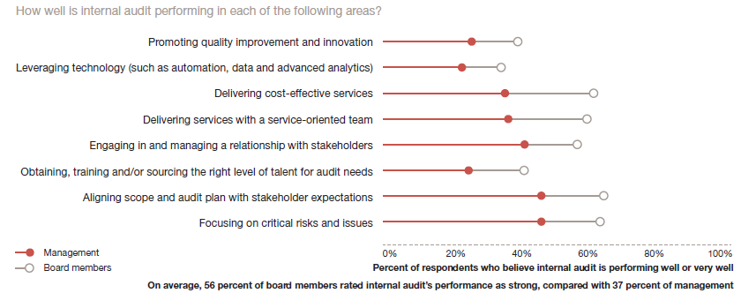
Board members and management disagree on how well audit performs on 8 key attributes
PwC 2013
Notes:
Source: PwC 2013 state of the internal audit profession study, page 8. survey of 1730 participants in 60 countries.
An equally critical insight here lies in the correlation between value and performance. Less than 50 percent of management saw internal audit as contributing significant value or performing well on any of the eight core attributes that are the necessary foundation of an internal audit function. While this management view is far from positive, at least there is a relationship between perceived value and performance. That is not the case with board members, who rated internal audit’s value contribution high yet rated its performance in core capabilities much lower, indicating they appear satisfied with average performance. If this disconnect persists, internal audit’s value to the organization may very well be minimized in the eyes of the board.
On average, 48 percent of CAEs rated internal audit performance as strong.
Companies’ management, board and internal audit should have candid conversations about the value internal audit is delivering, the areas on which it should be focusing and the specific contributions it should be making to help monitor the organization’s risk profile.

Slide 20
Audit is struggling to deliver value
What are the barriers to delivering the greatest value? Select all that apply.
Stakeholders are most satisfied with internal audit’s contribution in traditional coverage areas such as financial controls and fraud and ethics.
Stakeholders are least satisfied with internal audit’s contribution in less-traditional areas such as large program assessment, new product introductions, capital project management, and mergers and acquisitions.
Grant Thornton 2014; PwC 2013
Notes:
Source: Grant Thornton, Adding internal audit value: Strategically leveraging compliance activities, Chief Audit Executive Survey 2014, page 15. This is Grant Thornton’s fourth annual survey. The survey was administered online from November to December 2013. A total of 433 internal audit professionals responded. Respondents performed internal audit functions under varying titles, including CAE, vice president and director. Throughout this survey Grant Thornton referred to all respondents as CAEs.
“Stakeholders are most satisfied with internal audit’s contribution in traditional coverage areas such as financial controls and fraud and ethics.” [PwC 2013 state of the internal audit profession study pg.12]
“Stakeholders are least satisfied with internal audit’s contribution in less-traditional areas such as large program assessment, new product introductions, capital project management, and mergers and acquisitions.” [PwC 2013 state of the internal audit profession study pg.12]
Note:
Emphasize the perception of audit within the organization, gels with previous slides.

Slide 21
State of Auditing in 2014
Theme 3:
Expectations of Audit are changing
Business leaders want oversight, insight and foresight, but...
Boards of directors and senior management may have different priorities.

Slide 22
Priorities for corporate boards
Understand how technology is continuing to transform the competitive landscape The convergence of social media, the cloud, mobile devices, and big data – what Gartner calls “The Nexus of Forces” – is fundamentally changing the competitive landscape and creating new business opportunities, and the pace of change is accelerating. The key challenge for boards today is to help shape the company’s strategy and manage the related risks in a business environment undergoing massive change. This requires more than oversight. Does the board have insight and foresight about these technologies and their impact on the business, the industry, and the competitive environment? Are discussions within the traditional boardroom structure sufficient?
KPMG 2014
Notes:
Source: KPMG, Audit Committee Priorities for 2014, page 5.
The KPMG 2014 Global Audit Committee Survey report is based on responses from approximately 1,500 audit committee members in 34 countries, between September and November 2013. 51% of the respondents chair the audit committee.
“Technology has become so fundamental to business that many companies see themselves as technology companies that happen to sell retail goods, financial services, or some other product.” … [KPMG, On the 2014 Agenda: Growth, Governance, and Guiding the Business Forward, Insights from the 10th Annual Audit Committee Issues Conference, page 4]

Slide 23
Priorities for corporate boards
Recognize that good risk management entails both defense and offense While a solid defense is essential, more companies today also see good risk management supporting their offense – as a strategic capability helping people throughout the organization make smart risk-adjusted decisions, shaping strategy, and adding competitive value. Set the tone and closely monitor leadership’s commitment to that tone, and actively listen to the conversation below senior management and outside the corporate office Reinforce the right culture – i.e., what the company does, how it does it, and the culture of compliance… Is management actively “listening to the conversation” on social media to better understand the risks, opportunities, and changing attitudes and perceptions about the company?
KPMG 2014
Notes:
Source: KPMG, Audit Committee Priorities for 2014.
The KPMG 2014 Global Audit Committee Survey report is based on responses from approximately 1,500 audit committee members in 34 countries, between September and November 2013. 51% of the respondents chair the audit committee.

Slide 24
Priorities for audit committees
Stay focused on job #1: financial accounting and reporting Monitor key regulatory changes and proposals (potentially) impacting the external auditor’s role Leverage internal audit as a barometer of the company’s financial health – helping the audit committee understand the quality of financial controls, processes and people Make sure the company’s ethics and compliance programs are keeping up with new vulnerabilities to fraud and misconduct Understand the company’s significant tax risk appetite; pay particular attention to the global “tax morality” and “tax transparency” debates, and assess the impact on the company’s brand
KPMG 2014
Notes:
Source: KPMG, Audit Committee Priorities for 2014.
The KPMG 2014 Global Audit Committee Survey report is based on responses from approximately 1,500 audit committee members in 34 countries, between September and November 2013. 51% of the respondents chair the audit committee.
Jeff Jarvis’ book What Would Google Do describes how Dell, after it was trashed in blogs for crappy service, and its sales and share price dropped, it spent $150 million to beef up its call centers:
The company had been judging phone-center employees on their “handle time” per call, but Hunter realized this metric only motivated them to transfer calls, getting rid of complaining customers and making them someone else’s problem… 7,000 of Dell’s 400,000 customers calling each week suffered transfers seven times or more.
Instead of tracking “handle time,” Hunter began to measure the minutes per resolution of a problem. Resolution in one call became the goal… At the same time, technicians were reaching out to bloggers to fix problems…
Dell’s online PR turned around. After starting the program, by Dell’s calculations, negative blog buzz dropped from 49 percent to 22 percent. That is, half the blog posts mentioning Dell had been negative before the outreach began; afterwards, only about a fifth of them were.
The primary lesson of Dell’s story is this: Though we in business have said for years that the customer knows best and that the customer is boss, now we have to mean it. The customer is in control. If the customer isn’t in control, there’ll be hell to pay.

Slide 25
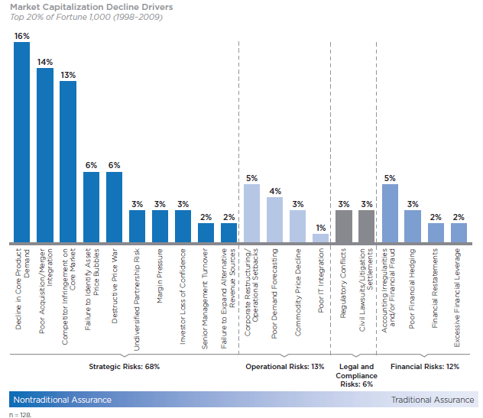
Because risks are changing …
Strategic risks cause 68% of severe market capital declines.
But the typical audit depart-ment spends the majority of its time on traditional assurance activities covering financial and compliance risks.
CEB 2010
Notes:
Source: Audit Director Roundtable, Next-Generation Auditing: Building the Audit Plan from Strategic Objectives, 2010.
Strategic risks continue to pose a much more significant threat to companies than more easily auditable risk areas.
Despite the threat of strategy risks, the typical audit department continues to spend the majority of its time on traditional assurance activities covering financial and compliance risks.
Audit can provide more effective assurance by evaluating key failure points in strategy development and execution.
Two primary challenges stand in the way of audit achieving a better balance of assurance activities: resource constraints and strategic risk translation (Provide meaningful context for auditing strategic risks by evaluating how they impact the achievement of objectives.)
Update:
Audit is likely providing too much assurance over well-controlled risks and too little over under-controlled risks. 2015 Audit Department Challenges and Priorities: A Look at the Issues and Forces Affecting Internal Audit Teams Over the Next Year, Results from Our 2015 Member Poll, Corporate Executive Board, October 29, 2014, pg. 7.

Slide 26
Expectations of Audit Are changing
In the year ahead, in which of the following areas would you like your internal audit function to devote more of its time and/or sharpen its focus (Select all that apply)?
KPMG, 2014
Notes:
Source: KPMG, 2014 Global Audit Committee Survey, question 26b.
Stakeholders are most satisfied with internal audit’s contribution in traditional coverage areas such as financial controls and fraud and ethics. [PwC 2013 pg.12]
Stakeholders are least satisfied with internal audit’s contribution in less-traditional areas such as large program assessment, new product introductions, capital project management, and mergers and acquisitions. [PwC 2013 pg.12]
Note:
When survey respondents were asked where they believe their internal audit organizations could add the most value without the constraints caused by compliance requirements, 77% chose “identifying improvement opportunities.” [Grant Thornton, Adding internal audit value: Strategically leveraging compliance activities, Chief Audit Executive Survey 2014, page 15]

Slide 27
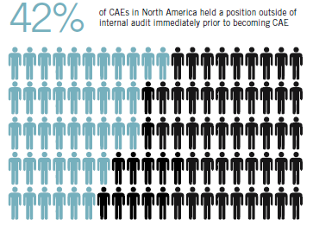
Chief Audit Executives are coming to their positions from outside the internal audit profession
“The bottom line is that internal audit needs people in the CAE chair who understand the business and speak like business leaders.”
Kelly Barrett, VP of Internal Audit and Corporate Compliance, Home Depot
IIA 2014
Notes:
Stakeholders are placing business leaders in CAE seats in high numbers just as the demand for business skills drives internal audit recruiting efforts.
Strong opinions surround the question of what experiences best serve the role of CAE. Without internal audit experience, a CAE coming from the business may not have an aptitude for governance, risk, and controls or an appreciation for the possibilities of internal audit. On the other hand, understanding the business is also vital, and can be significantly enhanced by having actually served in a hands-on role as a business executive. As Vice President of Internal Audit and Corporate Compliance at The Home Depot Kelly Barrett notes, “The bottom line is that internal audit needs people in the CAE chair who understand the business and speak like business leaders.”
Source: Pulse of the Profession: Continually Evolving to Achieve Stakeholder Expectations, North American Report, March 2014, by the Institute of Internal Auditors Audit Executive Center, page 9. The IIA Audit Executive Center’s 2014 Pulse of the Profession study surveyed 1,935 audit professionals around the world. In North America, 367 CAEs participated in the survey. The North American Pulse of the Profession report is based on these 367 responses from CAEs in North America.
In addition to analyzing the responses from 367 North American CAEs who participated in the survey, this year the Audit Executive Center spoke with 24 CAEs from the United States and Canada to gain insight from the CAE perspective on the survey results.

Slide 28
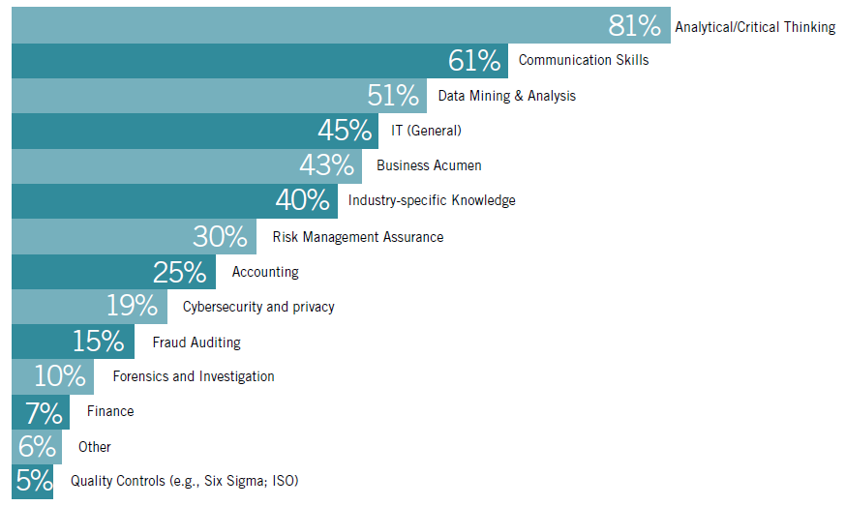
CAEs are hiring different skill sets
The above is 2014 data from the Institute of Internal Auditors. Note, additionally, that in PwC’s 2013 state of the internal audit profession study, only one third of survey respondents said internal audit was doing well in sourcing and training the right level of talent. Stake-holders cited lack of expertise, lack of enough talent and lack of the right kind of talent among the top barriers to improving internal audit performance.
IIA 2014
Notes:
Source: Pulse of the Profession: Continually Evolving to Achieve Stakeholder Expectations, North American Report, March 2014, by the Institute of Internal Auditors Audit Executive Center.
The IIA Audit Executive Center’s 2014 Pulse of the Profession study surveyed 1,935 audit professionals around the world (pg. 2). In North America, 367 CAEs participated in the survey. The North American Pulse of the Profession report is based on these 367 responses from CAEs in North America.
In addition to analyzing the responses from 367 North American CAEs who participated in the survey, this year the Audit Executive Center spoke with 24 CAEs from the United States and Canada to gain insight from the CAE perspective on the survey results.
Note: In PwC’s 2013 state of the internal audit profession study, only one third of survey respondents said internal audit was doing well in sourcing and training the right level of talent. Furthermore, stakeholders cited lack of expertise, lack of enough talent and lack of the right kind of talent among the top barriers to improving internal audit performance.
Quote:
Career auditors are disengaged: they currently exhibit very low discretionary effort and few of them are
committed to stay in their jobs.
from 2015 Audit Department Challenges and Priorities: A Look at the Issues and Forces Affecting Internal Audit Teams Over the Next Year, Results from Our 2015 Member Poll, Corporate Executive Board, October 29, 2014, p.7.

Slide 29
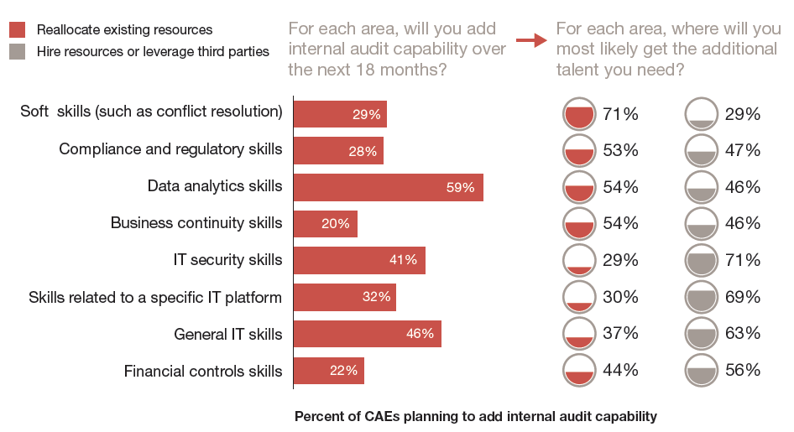
Where Internal Audit Will Get the Talent it Needs
PwC 2013
Notes:
Source: PwC, 2013 state of the internal audit profession study, page 11.

Slide 30
What Makes a High-Potential Employee?
Aspiration
The extent an employee desires:
Prestige and recognition
Advancement and influence
Financial rewards
Work-life balance
Overall job enjoyment
Ability
Engagement
A combination of the innate characteristics and learned skills that an employee uses to carry out their day-to-day work
Innate Characteristics
Mental/cognitive agility
Emotional intelligence
Learned Skills
Deep program knowledge
Data analytics
IT security
Interpersonal skills
Engagement consists of four elements:
Emotional Commitment— The extent that employees value, enjoy, and believe in their organization
Rational Commitment— The extent that employees believe that staying with their organization is in their best interest.
Discretionary Effort— Employee willingness to go above and beyond the call of duty.
Intent to Stay—Employee desire to stay with their current organization.
Aspiration
Engagement
Ability
“The true investment in the knowledge society is not in machines and tools
but in the knowledge of the knowledge worker.” Peter Drucker, 1994
CEB 2013
Notes:
Source: High-Potential Employee (HIPO) Development: “Best of CEB on Talent” Series Guidebook, Corporate Executive Board, 2013, slide 4.
Quote:
Career auditors are disengaged: they currently exhibit very low discretionary effort and few of them are committed to stay in their jobs.
from 2015 Audit Department Challenges and Priorities: A Look at the Issues and Forces Affecting Internal Audit Teams Over the Next Year, Results from Our 2015 Member Poll, Corporate Executive Board, October 29, 2014, p.7.
Mention the Talent War
Q: What happens if we train them and they leave?
A: What happens if we don’t and they stay?

Slide 31
Top Challenge for Audit Departments in 2015
The top challenge for Audit departments is to advance their data analytics capabilities.
The second and third highest challenges – improving business acumen and garnering sufficient skill sets to cover the organization’s risks – both relate to development of audit talent.
Audit Technology
Audit Talent & Skills
N=117
Scale ranging from 1 (very low) to 5 (very high)
Enterprise Challenges
External Challenges
CEB 2014
Notes:
Source: 2015 Audit Department Challenges and Priorities: A Look at the Issues and Forces Affecting Internal Audit Teams Over the Next Year, Results from Our 2015 Member Poll, Corporate Executive Board, October 29, 2014.
Adapting the audit approach to keep pace with change in the business and control environment is a high or very high priority for almost 40% of departments. [pg.5]
Note that AGA surveyed OIG’s in 2013 and 2014. The OIG’s top concerns were:
1. IT Security
2. Data analytics
3. Specialized program knowledge

Slide 32
State of Auditing in 2014
Theme 4:
Is Continuous Assurance (data analytics) the future of the Auditing Profession?
Notes:
In 2013, the digital universe grew 40% as businesses created and used more than 4.4 trillion gigabytes of electronic information. The variety of information is also expanding to include data on customer behaviors and social media posts. Without comprehensive governance frameworks, it will be almost impossible to ensure effective management and protection of this information. Rapid decentralization of data ownership and increasing reliance on information to guide business decisions makes effective information governance particularly critical.
2015 IT Audit Hot Spots, Corporate Executive Board, Nov 2014, page 5.

Slide 33
Audit can evolve from assurance provider to trusted advisor
Align expectations
Build capabilities
Deliver quality
Increase value
Unrealized value
Trusted Advisor
Providing value-added services and proactive strategic advice to the business well beyond the effective and efficient execution of the audit plan.
Insight Generator
Insight Generator
Taking a more proactive role in suggesting meaningful improvements and providing assurance around risk.
Problem Solver
Problem Solver
Problem Solver
Bringing analysis and perspective on root causes of issues identified in audit findings, to help business units take corrective action.
Assurance Provider
Assurance Provider
Assurance Provider
Assurance Provider
Delivering objective assurance on the effectiveness of internal controls.
PwC 2014
Notes:
Source: PWC, 2014 State of the Internal Audit Profession Study, March 2014, page 5. An online survey of 1,920 executives from 24 industries in 37 countries, and 1-on-1 interviews with more than 125 stakeholders.

Slide 34
State of Auditing in 2014
Continuous auditing (CA)-is the collection of audit evidence and indicators by an internal auditor on information technology (IT) systems, processes, transactions, and controls on a frequent or continuous basis, throughout a period.
By contrast, continuous monitoring (CM)-is a feedback mechanism used by management to ensure that controls operate as designed and transactions are processed as prescribed. This monitoring method is the responsibility of management and can form an important component of the internal control structure.

Slide 35
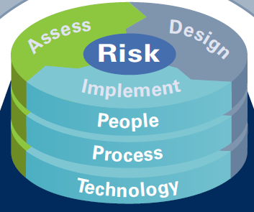
Economic Drivers and Benefits of Implementing CA/CM Capabilities
CONTINUOUS MONITORING
Transparency
Accountability
Greater Efficiency
Improved Oversight
Enhanced Controls
Improved Forecasting
Timely Information
Reduced Complexity
Reduced Cost
Improved Performance
CONTINUOUS ASSURANCE
Improve Risk
Management
Optimize Costs and Improve Profitability
Employees
Monitor for Potential Fraud and Misconduct
The media
Industry & Functional Knowledge
Local
communities
Address Regulatory Pressures
Process optimization is the objective, with sustainable cost savings the result.
Non-governmental
organizations
KPMG 2009
Notes:
Source: What is Driving Continuous Auditing and Continuous Monitoring Today? KPMG, 2009.
Defining CA and CM
Continuous auditing (CA)-is the collection of audit evidence and indicators by an internal auditor on information technology (IT) systems, processes, transactions, and controls on a frequent or continuous basis, throughout a period.
By contrast, continuous monitoring (CM)- is a feedback mechanism used by
management to ensure that controls operate as designed and transactions are
processed as prescribed. This monitoring method is the responsibility of management and can form an important component of the internal control structure.
Definitions taken from KPMG LLP’s Continuous Auditing and Continuous Monitoring: Transforming Internal Audit and Management Monitoring to Create Value, 2008.

Slide 36
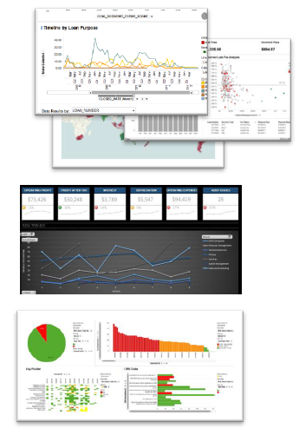
Characteristics of analytics today
Analytics: discovery and communication of meaningful patterns in data
Big data: collection of large and complex data sets
Financial, Operational,
IT Systems
External
Visualization
Data
Trending & Comparison
Speed and portability: available anytime, anywhere
Dashboarding
PwC 2013
Notes:
Source: PwC, The Data Conundrum: Finding Your Path with Data Analytics, December 2013. Also cited in PwC’s 2013 State of the Internal Audit Profession.
Quote:
Convergence of markets from globalization providing similar products and services to similar customers with similar operating models will lead to convergence of data requirements across organizations underpinned by standard data sets….
Today, decision making is primarily based on information residing in scorecards, dashboards, and reports that shed light on how business is performing against predetermined targets…. For management to have real-time view of the business, real-time dashboards will become reality…. We will see analytics emerge as a core enterprise function to deliver better business insights that improve decisions to drive business strategy and manage performance. [KPMG, Business Intelligence of the Future, 2013, page 7]
What about the Innovator’s Dilemma?

Slide 37
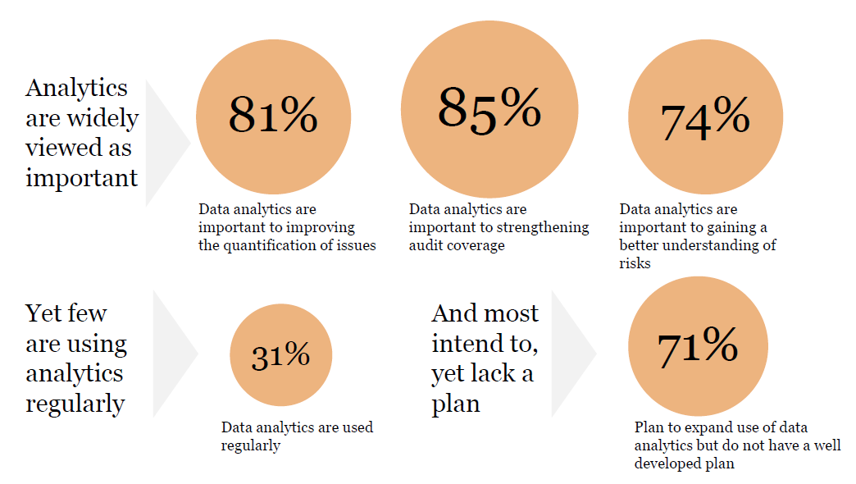
The state of analytics in auditing
PwC 2013
Notes:
Source: PwC, The Data Conundrum: Finding Your Path with Data Analytics, December 2013.
Also cited in PwC’s 2013 State of the Internal Audit Profession. PwC conducted an online survey in October and November 2012. Nearly 1,100 chief audit executives and more than 630 stakeholders including CEOs, audit committee chairs, other board members and senior finance and risk managers representing 18 industries and 60 countries, took part in this survey. [pg. 7]
Quote:
Convergence of markets from globalization providing similar products and services to similar customers with similar operating models will lead to convergence of data requirements across organizations underpinned by standard data sets…. Today, decision making is primarily based on information residing in scorecards, dashboards, and reports that shed light on how business is performing against predetermined targets…. For management to have real-time view of the business, real-time dashboards will become reality…. We will see analytics emerge as a core enterprise function to deliver better business insights that improve decisions to drive business strategy and manage performance. [KPMG, Business Intelligence of the Future, 2013, page 7]

Slide 38
Four types of analytics
Type | Description
Descriptive: What Happened? | Descriptive models about the state of events, trends, patterns and relationships in existing data. There is no dependent variable to predict.
Diagnostic: Why did it happen? | Developed to understand the causes of an outcome; can be used to account for dependencies among causal factors.
Predictive: What will, or is likely, to happen? | Predict values of one or more dependent variables from independent variables; support leading performance measures.
Prescriptive: What is the recommended next action? | Define the best response, given that an event or series of events has taken place.
KPMG 2014
Notes:
Source: KPMG, Transforming Internal Audit: A Maturity Model from Data Analytics to Continuous Assurance, 2014, page 4. Also, KPMG, Business Intelligence of the Future, 2013, page 4.
Quote:
Convergence of markets from globalization providing similar products and services to similar customers with similar operating models will lead to convergence of data requirements across organizations underpinned by standard data sets…. Today, decision making is primarily based on information residing in scorecards, dashboards, and reports that shed light on how business is performing against predetermined targets…. For management to have real-time view of the business, real-time dashboards will become reality…. We will see analytics emerge as a core enterprise function to deliver better business insights that improve decisions to drive business strategy and manage performance. [KPMG, Business Intelligence of the Future, 2013, page 7]
Note:
Also, see Gartner, Nexus of Forces, June 2013, slide 32.

Slide 39
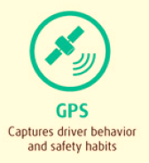
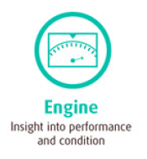
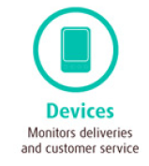
How United Parcel Service Uses Analytics
Sensors that capture over 200 data points for more than 80,000 “telepathic trucks” are downloaded every day. Results:
364 million miles avoided since 2001 – enough to drive around the Earth 14,617 times!
206 million minutes of idle time reduced in 2012.
39 million gallons of fuel saved through route optimization since 2001.
13,000 tons of carbon emissions avoided in 2012.
Notes:
Source: USP Big Data Infographic
http://www.pressroom.ups.com/pressroom/staticfiles/pdf/fact_sheets/UPS-big-data-infographic-900x2708.pdf
See also, Why UPS Spends More Than $ 1 Billion on Big Data Annually, by Mark van Rijmenam
http://smartdatacollective.com/bigdatastartups/201286/why-ups-spends-over-1-billion-big-data-annually

Slide 40
State of Auditing in 2014
What about the Postal Service and the OIG?

Slide 41
The Postal Service is experiencing the same forces as its customers, and responding by transforming itself with technology.

Slide 42
Postal Service Journey to Enterprise Analytics
USPS 2014
Notes:
Source: CIO Updates, August 19, 2014 presentation by Jim Cochrane, Chief Information Officer and EVP.

Slide 43
Postal Service Journey to Enterprise Analytics
USPS 2014
Notes:
Source: CIO Updates, August 19, 2014 presentation by Jim Cochrane, Chief Information Officer and EVP.

Slide 44
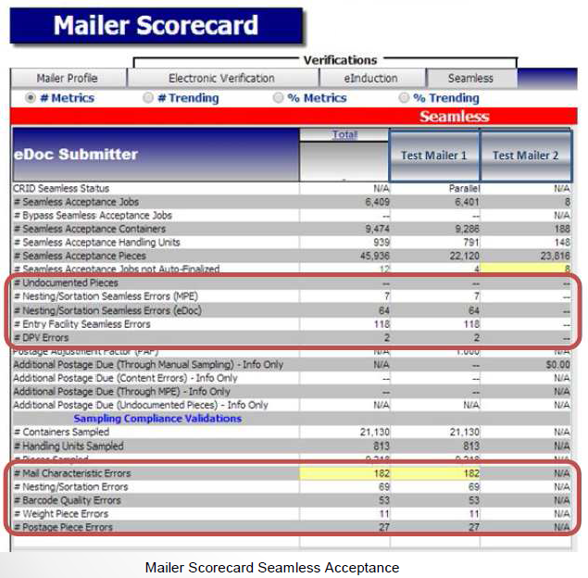
Postal Service Journey to Enterprise Analytics
The Mail Entry Roadmap describes the Postal Service’s key initiatives to streamline the acceptance, induction, and verification of commercial mailings. These key initiatives leverage existing technology to:
Improve mail quality by sharing information on mail preparation, identification of trends as well as trend-based quality measurements
Simplify the induction of mailings through automated and standardized acceptance, verification, and induction processes
Provide end-to-end visibility through scan data.
USPS 2014
Notes:
Source: US Postal Service Mail Entry Roadmap, October 20, 2014, page 27.
Recall the reference to real-time dashboards in the Notes Page view of slide 36.

Slide 45
Just when you think you have it all together…
U.S. Postal Service Says It Was Victim of Data Breach
Personal Information of More Than 800,000 People Could Be Compromised
Employees, some retirees and staffers of the Postal Regulatory Commission, the U.S. Postal Inspection Service and the Postal Service Office of Inspector General have been affected, the Postal Service said. An unknown number of customers also could have been affected, though not to the same degree, officials said.
USPS 2014
Notes:
Source: US Postal Service Mail Entry Roadmap, October 20, 2014, page 27.

Slide 46
Dashboard

Slide 47
Where Does OIG Need More Real-Time Insight?
Nexus of Forces
Customers &
Stakeholders
Products & Services
Operations
New business scenarios emerge as new technologies converge and mutually reinforce each other…
Notes:
My opinion:
Communication skills
Deep program knowledge
Data analytics
IT security

Slide 48
OIG Countermeasures and Performance Evaluation Team Collaborative Approach
Business Customer
Provides business question
Joins modeling team
Describes success
Defines value
Owns completed model
Claims model result
CAPE
Develops model technology
Drives modeling team
Shows what success looks like
Builds valuable model
Delivers model
Claims model delivery
Notes:
Fiscal Year 2012
133 Investigations Opened
$10,203,400 Financial Impact
Fiscal Year 2013
209 Investigations Opened
$22,946,434 Financial Impact
304 Average Monthly Users
Fiscal Year 2014
50 Investigations Opened
$5,564,868 Financial Impact
284 Average Monthly Users

Slide 49
OIG Analytics: Contract Fraud, Map View
Copyright © Elder Research, Inc. 2012
All Rights Reserved.
Notes:
Scores 13,000 contracts from 3 portfolios in CAMS: supplies, services, and mail equipment.
Examines all open contracts, plus contracts that have closed within the past 3 years.
Considers different facets of each contract, including supplier information, contract activity, payments, and contracting officer/requestor/COR/buyer.
Example metrics include looking for unusual patterns in contract growth, payment irregularities, and cost outliers.
Each contract gets a risk score from 0-100.

Slide 50
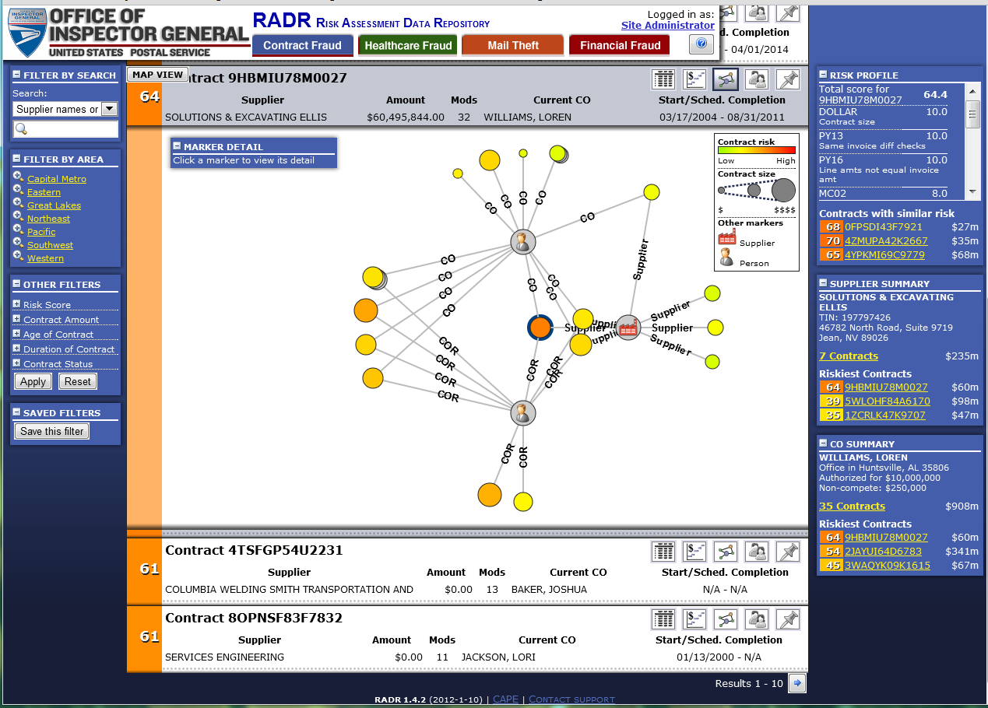
OIG Analytics: Contract Fraud List View
Link analysis.
Click on the links to see more information appear in the upper left corner.
Copyright © Elder Research, Inc. 2012
All Rights Reserved.
Notes:
Note: the last two buttons are not available at this time.

Slide 51
Sources
Author | Survey Title | Participants | Interviews | Industries | Countries
KPMG | 2014 Global Audit Committee Survey | 1500 |  |  | 34
PwC | 2014 17th Annual Global CEO Survey | 1344 | 1344 |  | 68
 | 2014 state of the internal audit profession study | 1920 | 125 | 24 | 37
 | 2014 the five behaviors that accelerate value from digital investments; 6th annual digital IQ survey | 1494 | n/a | 11 | 36
 | 2014 risk in review: re-evaluating how your company addresses risk | 1940 |  |  | 37
 | 2013 state of the internal audit profession study | 1730 | 140 | 18 | 60
 | 2013 global innovation survey: Breakthrough Innovation and Growth | 1757 | 1757 | 30 | 25
Protiviti | 2014 Internal Audit Capabilities and Needs Survey: Assessing Top Priorities for Internal Audit Functions | 600 |  | 19 | 7 continents
 | 2014 IT Priorities Survey, Today’s IT Organization – Delivering Security, Value and Performance Amid Major Transformation, March 2014 | 1100 |  | 16
IIA | 2014 North American Pulse of the Profession Survey | 367 | 24 | 26 | 3
Grant Thornton | 2014 Chief Audit Executives Survey, Adding internal audit value: strategically leveraging compliance activities | 433 |  | 11
AGA | AGA's Inspector General Survey: Effective Oversight in a Changing Environment Sept 2013

Slide 52
Sources
 | Other Documents
Author | Title
KPMG | Transforming Internal Audit: A Maturity Model from Data Analytics to Continuous Assurance, 2013
KPMG | On the 2014 Agenda: Insights from the 10th Annual Audit Committee Issues Conference
 | Audit Committee Priorities for 2014
KPMG | Business Intelligence of the Future
 | Next Generation IT Operating Models
 | The Transformation of IT Risk Management
 | Evolution of IT: How Do You Define Innovation?
PwC | The Data Conundrum: Finding Your Path with Data Analytics, Dec 2013
 | Reinventing Information Technology in the Digital Enterprise
Gartner | The Nexus of Forces, Gartner Point of View, June 2013
 | Predicts 2014: Nexus of Forces Drives Evolution of Integration Strategy, Nov 2013
Deloitte | Analytics Trends in 2014
COSO | Improving Organizational Performance and Governance: How the COSO Framework Can Help, Feb 2014
 | Enterprise Risk Management: Understanding and Communicating Risk Appetite, Jan 2012
CEB | High-Potential Employee (HIPO) Development: “Best of CEB on Talent” Series Guidebook, Corporate Executive Board, 2013
CEB | Next-Generation Auditing: Building the Audit Plan from Strategic Objectives, 2010

Slide 53
Questions?
rmitchell@uspsoig.gov
Robert Mitchell, MBA, CPA
Director, Strategic Planning and Performance
US Postal Service Office of Inspector General

