Slide 1
The Gift of Quality
Enabling Human Exploration
March 2015

Slide 2
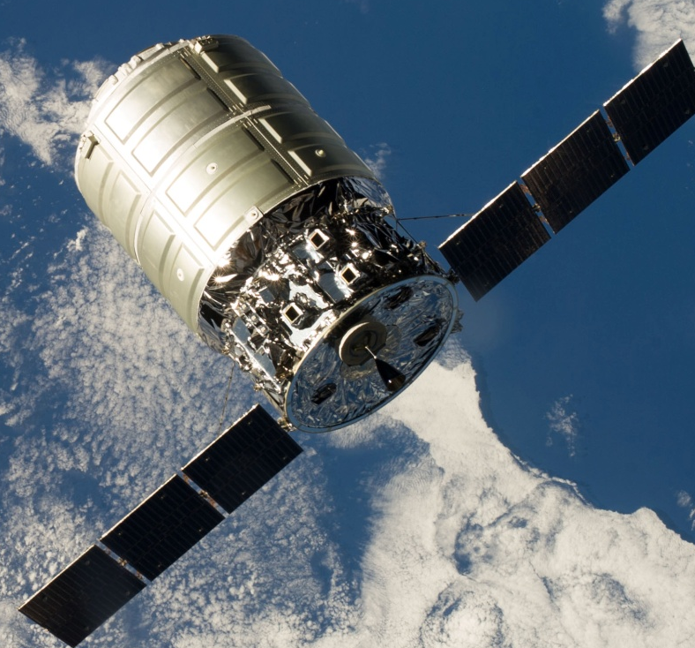
Speaker: David Swanson
Education: Masters in Space Operations, Electrical Engineering and Military Arts & Sciences
Experience:
24.5 Years in US Air Force;
- Military Space Operations and Acquisition
- Director of Engineering, Space and Missiles Systems Center, LA AFB
- Assistant Professor at USAFA
3.75 Years as Senior Director, Safety and Mission Assurance, Orbital ATK, Space Systems Group
- Safety and Environmental Director
- Quality Function: Internal and Supplier Oversight
- Mission Assurance Function
- Specialty Engineering: Reliability, Radiation, Parts/Materials/Processes, Failure Analysis
- Configurations Management
- ISO 9000 and AS 9100 Quality Management System
Topics
Introduction: The Gift of Quality
Overview of Orbital ATK
How Orbital Bakes in Mission Success
Resupplying the International Space Station

Slide 3
Quality is “Non-Value” Added
QUALITY IS A “COST AVOIDANCE”
ACTIVITY _{Lean Thinking}
The Gift of Quality
    Specified Performance
    Reduces Cost
    On Time Delivery

Slide 4
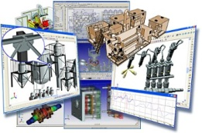
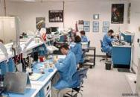
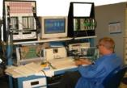
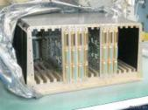
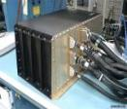

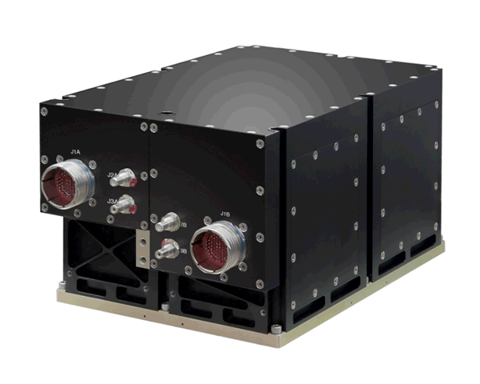
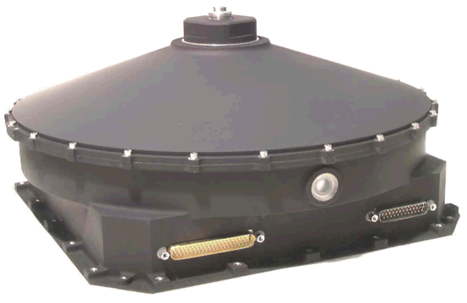
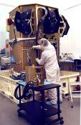
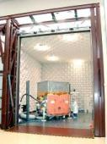
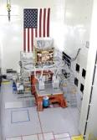
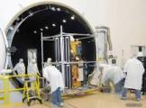

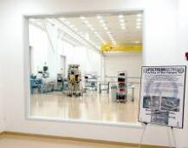

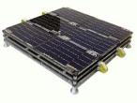
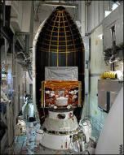
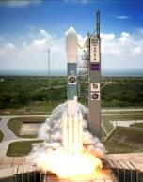
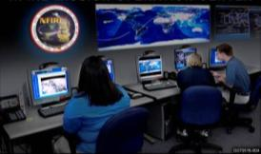

Global Value Stream
  Market Forces Drive Business to Reduce Quality Oversight
    The Need to be Quicker to Market
    Consumer Electronics Influence Decision Makers
        Quickly Evolving, Disposable, Durable (on Earth)
    Pressure to Reduce Cost and Meet Demand for Lower Price
    Schedule Pressures in Design and on the Factory Floor
Manufacture
Box Test
(Includes
Environments)
Design
Manual Card Assembly
Card Test
Box Assembly
Space Vehicle (SV) Integration
SV Environmental Tests
Procure
TVAC
World-wide Supply Base
EMI
Acoustic - Vibe
Vehicle I&T
SV Launch Site Support
Mission OPS
SV
Shipment
4

Slide 5
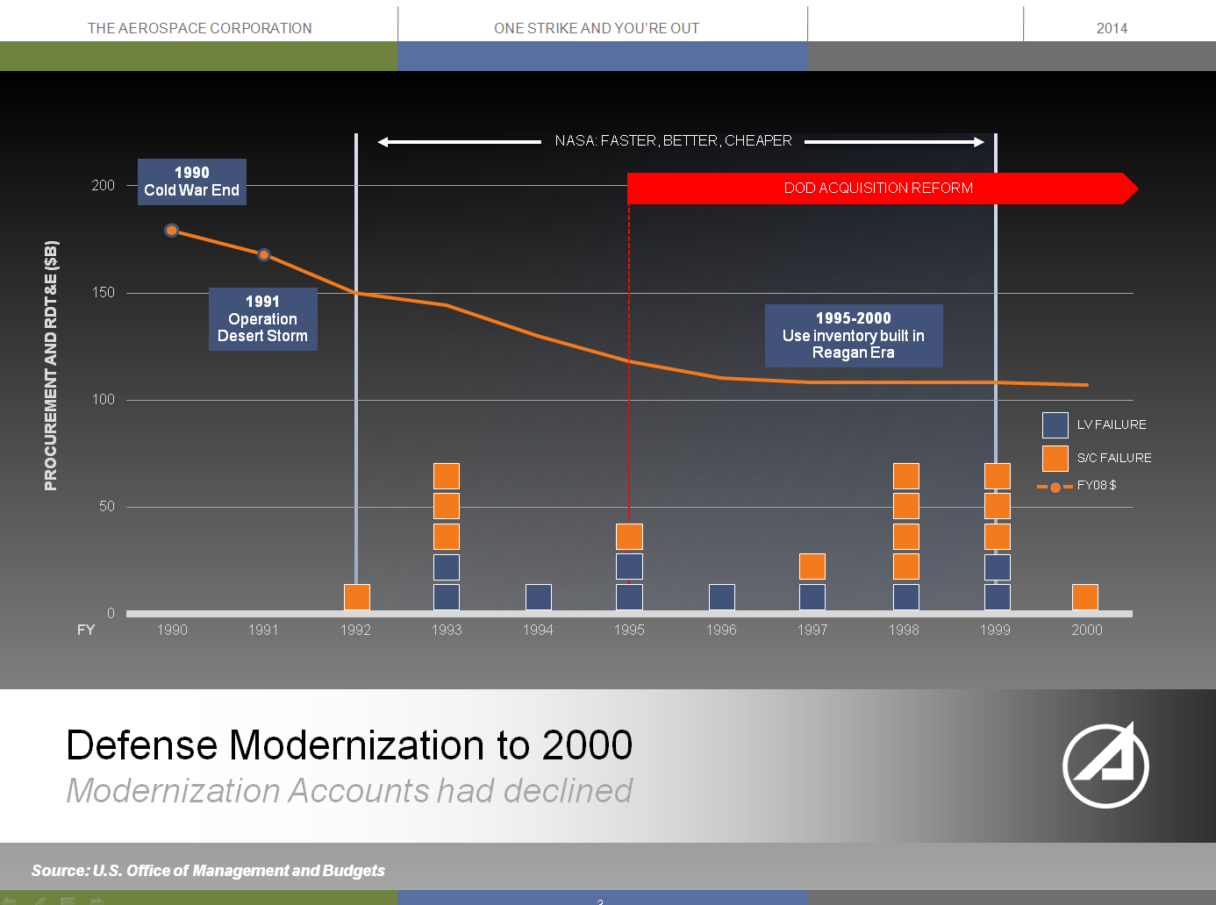
SPACE - “One Strike and You’re Out Business”
Dr. W. F. Ballhaus, Jr., President and CEO, Retired
The Aerospace Corporation

Slide 6
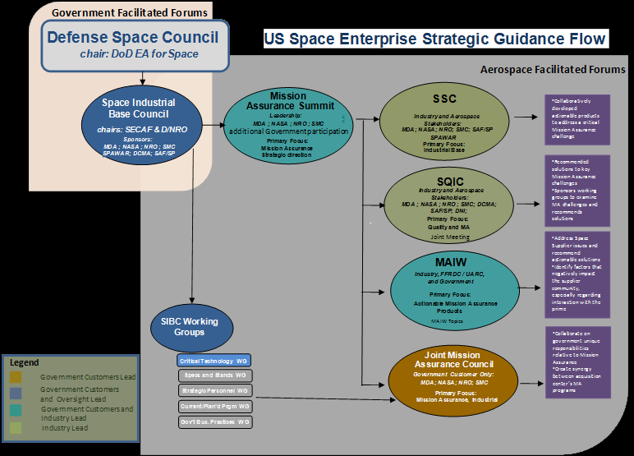
Collaborative Mission Assurance Community

Slide 7
An Introduction to
Orbital ATK, Inc.
Company Overview Presentation
February 2015

Slide 8


Introducing the New Orbital ATK
Aerospace Systems
Defense Systems
Innovation… Delivered
The Partner You Can Count On
$4.5 Billion (2013 Pro-Forma Revenue) Global Aerospace and Defense Systems Company
Innovative, Affordable Products for Government and Commercial Customers
  Launch Vehicles, Propulsion Systems and Aerospace Structures
  Missile Products, Defense Electronics, Armament Systems and Ammunition
  Satellites, Space Components and Technical Services
12,500 Employees, Including 4,300 Engineers and Scientists
R&D, Production and Test Facilities in 17 States

Slide 9





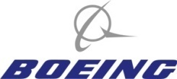














Major Customers and Market Segments
Commercial/
International
26%
56%
18%
National Security
NASA/Civil
Government
Approximate Revenue Distribution

Slide 10
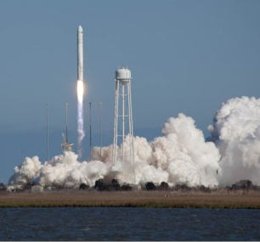

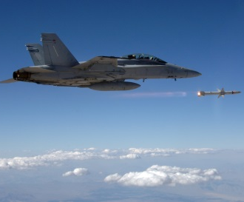
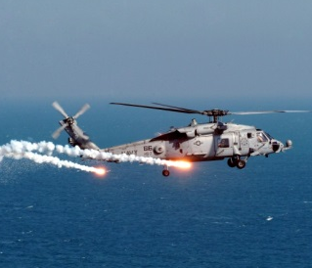
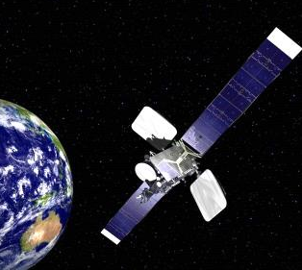
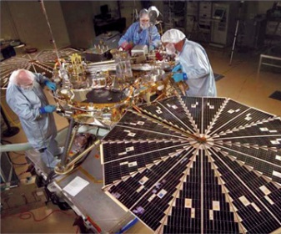
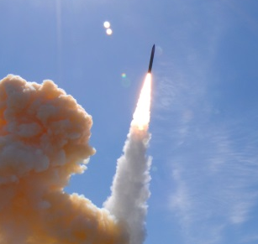
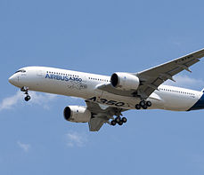


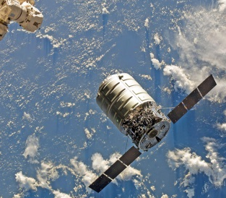
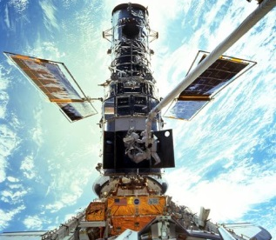
Three Operating Groups and 12 Product Lines
Flight Systems Group
Space Launch Vehicles
Rocket Propulsion Systems
Missile Defense Systems
Aerospace Structures
Defense Systems Group
Tactical Missile Products
Defense Electronic Systems
Armament Systems
Ammunition and Energetics
Space Systems Group
Commercial Satellites
Government Satellites
Spacecraft Components
Space Technical Services
Approximate Revenue Distribution

Slide 11
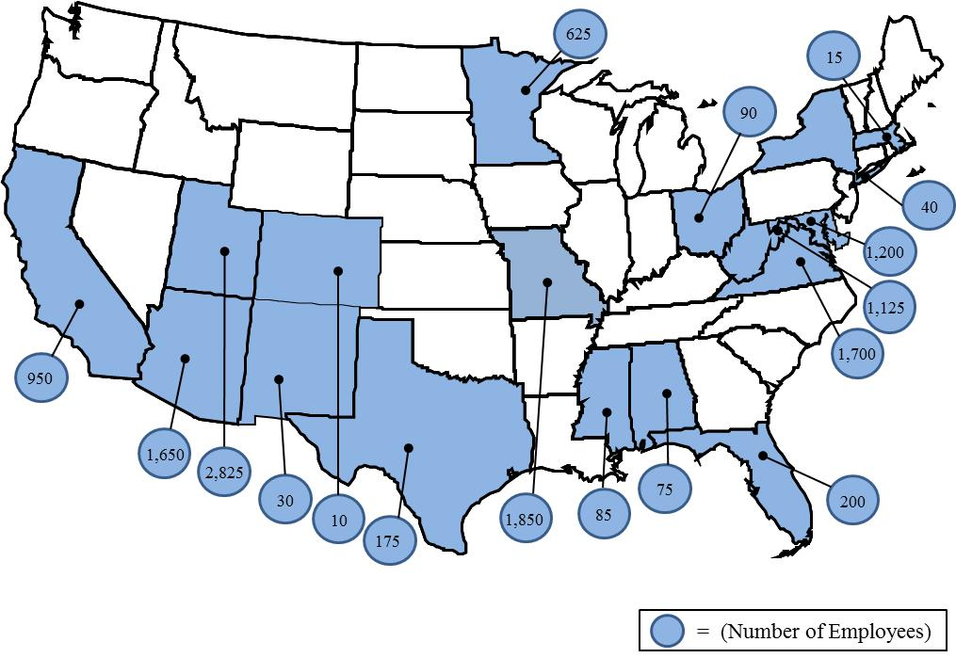
Extensive Human and Physical Resources
Over 12,500 Employees Dedicated to Aerospace and Defense Customers
  4,300 Engineers and Scientists
  7,250 Manufacturing and Operations Specialists
  1,100 Management and
  Administration Personnel
Facilities in 17 States With Over 19
Million Sq. Ft. of R&D, Manufacturing,
Test, Operations and Office Space
  6.1 Million Sq. Ft. Owned
  5.3 Million Sq. Ft. Leased
  8.1 Million Sq. Ft. Government Owned

Slide 12
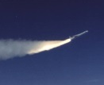
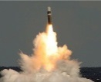

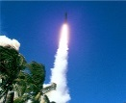
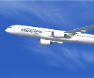
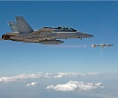

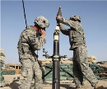
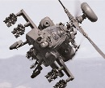
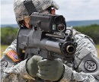
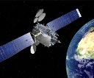
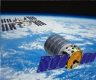



A History of Innovation and Operations Excellence
Flight Systems
First Private Developer and Operator of Space Launch Vehicles… More Than 85 Flown
or in Production
Leading Producer of Solid Rocket Propulsion Systems… Over 16,000 Motors Built to Date
Primary Supplier of Long-Range Missile Defense Interceptors and Target Systems… More Than 300 Vehicles Built or Under Contract
Innovator in Advanced Composite Structures Engineering and Manufacturing for Aerospace Applications
Defense Systems
Pioneer in Tactical Missile Propulsion, Precision-Guided Munitions and Advanced Weapons
World’s Largest Manufacturer
of Small- and Medium-Caliber Ammunition… More Than 8
Billion Rounds Produced in
Last 5 Years
Principal Supplier of Medium-Caliber Gun Systems for U.S.
and NATO… 15,000-Unit
Installed Base
Leading Domestic Armament Facility Operator and International Co-Production Partner
Space Systems
Major Builder of Satellites for Commercial and Government Customers… Over 165 Delivered and Another 95 in Production
Pioneer in Human and Robotic In-Space Satellite Servicing and Logistics Systems
Industry-Standard Supplier of Spacecraft Components and Subsystems… Products on More Than 800 In-Orbit Satellites
Leading Operator of Small Research Rockets and High-altitude Scientific Balloons…
30 Missions Conducted Per Year

Slide 13
Space Systems Group

Slide 14
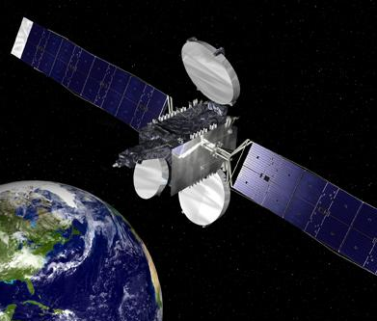
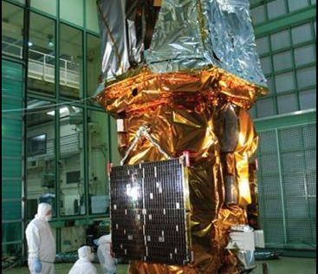
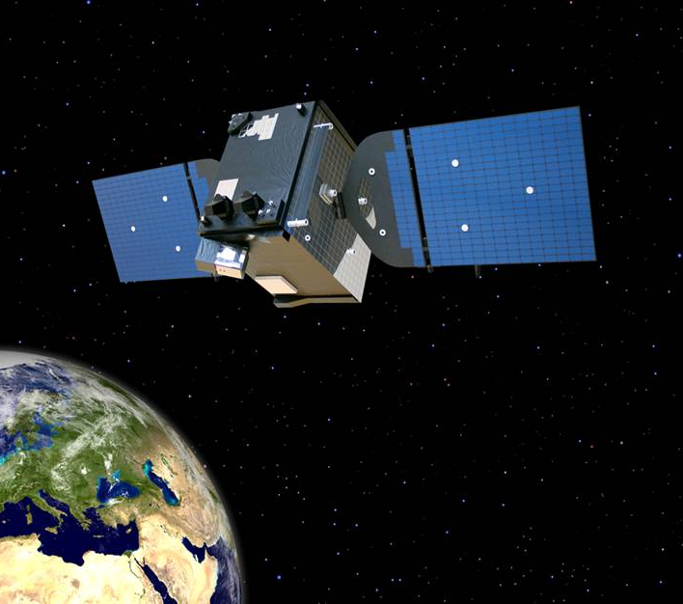
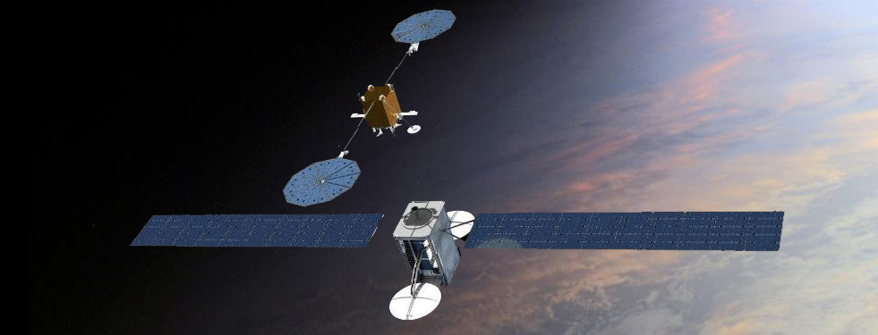
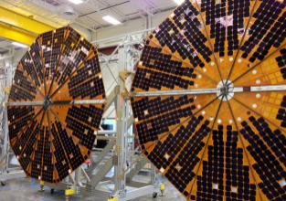
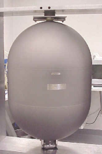

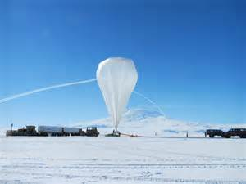
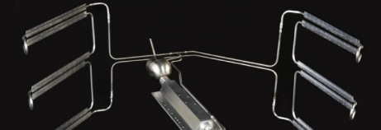
Space Systems Group Overview
Commercial Satellites
Scientific Spacecraft
Human Space Systems
National Security Satellites
Advanced Space Systems
Space Components
Space Engineering Services
Research Rocket and
Balloon Operations
Annual Sales of About $1.2 Billion
Workforce of Approximately 2,700 People
Major Operations in Virginia, Maryland, California,
Arizona, Texas and Utah

Slide 15
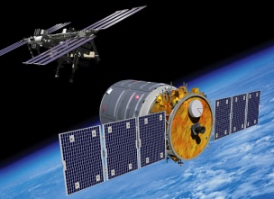
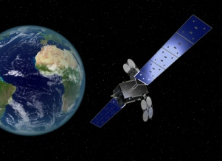












Space Systems Group (SSG) Business Lanes
Civil & Defense
Programs
Jean Floyd
Commercial
Satellites
Chris Richmond
Space Components
Dave Shanahan
Technical Services
John Pullen
Delivering Some of Orbital ATK’s Most Innovative and Challenging Programs -
Frank Culbertson, SSG President
Delivering Some of Orbital ATK’s Most Innovative and Challenging Programs -
Frank Culbertson, SSG President

Slide 16

SSG Locations
Magna,
Utah
Colorado Springs,
Colorado
Beltsville,
Maryland
Monterey,
California
Pasadena,
California
Greenbelt,
Maryland
Goleta,
California
Commerce,
California
Dulles,
Virginia
Wallops Island,
Virginia
El Segundo,
California
San Diego,
California
Total
Employees:
2700
Gilbert,
Arizona
Palestine,
Texas
White Sands,
New Mexico
Houston,
Texas
SSG Has Operating Locations in 8 States

Slide 17

Orbital ATK Space System Capabilities
Environmental
LEO Systems
GEO Systems
Mini
60 kg / 75 W Payload
1-5 Year Life
12-18 Month Delivery
RapidStar-1
Pegasus, or
Minotaur I
Spacecraft Control
Small
550 kg / 750 W Payload
1-5 Year Life
16-36 Month Delivery
RapidStar-2 or
LEOStar-2
Pegasus, Minotaur I, Minotaur IV or Minotaur C
Spacecraft Control
Medium
4,000 kg / 750 W Payload
7-10 Year Life
21-36 Month Delivery
LEOStar-3
Minotaur IV
or
Antares
Spacecraft Control
Mini
100 kg / 1.5 kW Payload
5-7 Year Life
27-30 Month Delivery
GEOStar-1
Minotaur V
or
Antares (Future)
Spacecraft Control
Small
500 kg / 5.5 kW Payload
15-18 Year Life
24-27 Month Delivery
GEOStar-2
External Launch
Vehicles
Spacecraft Control
Medium
800 kg / 8.0 kW Payload
15-18 Year Life
27-30 Month Delivery
GEOStar-3
External Launch
Vehicles
Spacecraft Control
Mission Capability
Satellite Bus
Launch Vehicle
Ground Software

Slide 18
Orbital ATK Space System Capabilities
Environmental
In-Space
Servicing
Constellation
ESPA-Based Systems
Exploration Systems
Micro
15 kg / 360 W Payload
1-3 Year Life
12-15 Month Delivery
MicroStar-1
Rideshare, Pegasus or
Minotaur I
Constellation Control
Mini
250 kg / 500 W Payload
1-5 Year Life
22-24 Month Delivery
ESPAStar-1
Antares or
External Launch Vehicle
Spacecraft Control
Small
600 kg / 1.5 kW Payload
1-7 Year Life
22-24 Month Delivery
ESPAStar-2
Antares or
External Launch Vehicle
Spacecraft Control
GEO
1,700 kg / 3.0 kW Payload
Rendezvous Capability
6-15 Year Life
21-36 Month Delivery
Gemini
Minotaur IV
or Antares
Complete Ground Segment
Human
3,300-5,000 kg (Pressurized)
Rendezvous Capability
6 month - 10 year
24-27 Month Delivery
Cygnus
Antares or External Launch Vehicle
Complete Ground Segment
Interplanetary
210 kg / 250 W Payload
Electric Propulsion
7-10 Year Life
36-42 Month Delivery
ExoStar
External Launch
Vehicles
Spacecraft Control
Mission Capability
Satellite Bus
Launch Vehicle
Ground Software

Slide 19

Orbital: Baking in Mission Success

Slide 20

Mission Assurance Leads to Mission Success!
Mission Success – The achievement of specified performance requirements and the expectations of the users and operators in terms of safety, operability, suitability and supportability.
Mission Assurance – “The Disciplined application of general systems engineering, quality, and management principles towards the goal of achieving mission success, and, toward this goal, provides confidence in its achievement.”
Aerospace Mission Assurance Guide
Orbital’s COTS and CRS missions to Orb-2 have been 100% Successful
  Cygnus rendezvous and berthing activities highly successful
  Disposal cargo successfully transferred
  Cygnus reentry implemented safely and successfully
Orbital’s dedication to quality products has significantly contributed to mission accomplishment.
Orbital’s quality products led to three missions safely completed to the ISS and its crews.
Orbital’s Industrial Safety Record has Surpassed Our Industry Peers for More Than a Decade

Slide 21


Quality Starts with Management
Orbital’s Quality Management System (QMS) is Third Party Registered
  Third party registration and certified to ISO 9001:2008 and AS9100 Rev C
  Standard business practices cover lifecycle of product development, build and delivery
  Mandatory employee training includes: business ethics; safety; risk management; design and workmanship standards; etc.
  Includes an internal audit system to monitor ISO and AS compliance
  Overseen by a Continuous Improvement management team to improve and refine our business procedures
Orbital is Actively Engaged within Industry
  Member of American Society for Quality (ASQ)
  Quality Leadership Forum (QLF)
  Joint Audit Planning Committee (JPAC)
  Aerospace Space Quality Improvement Council (SQIC)
  Mission Assurance Improvement Workshop (MAIW)
  Corporate member of the Mission Assurance Summit
  Member of GIDEP

Slide 22

A Culture of Continuous Improvement
Continuously Improving Our Processes
  Non-Conformance Process Improves Flight Hardware/Software (Internal and at Suppliers)
    Managed by the Program in Material Review and Failure Review Boards
  Corrective Action Boards (CAB) Broaden Perspective into Standards, Procedures and Processes
    Managed by the Technical Operations Functional Managers in the Integrated Enterprise CAB
  Demand for Supplier Improvement
    Insight: Supplier Corrective Action Requests (SCAR)
    Oversight: Strategic Supplier Improvement Plan (SSIP)
  Corrective/Preventative Action Request (CPAR) is the Highest Priority and Impacting Improvement Action
FRB/MRB
Containment
Root Cause
Corrective Actions
Follow-up

Slide 23
Monitoring Quality
Manufacture
Box Test
(Includes
Environments)
Design
Manual Card Assembly
Card Test
Box Assembly
Space Vehicle (SV) Integration
SV Environmental Tests
Procure
TVAC
World-wide Supply Base
EMI
Acoustic - Vibe
Vehicle I&T
SV Launch Site Support
Mission OPS
SV
Shipment
© [2014] Orbital Sciences Corporation. All Rights Reserved.
23

Slide 24
Containment – Reducing CoPQ
 |  |  |  |  | Where the Defect was introduced
 |  |  |  |  | Design | Vendor Level |  |  |  | Intermediate Level |  |  |  | Sub-Sys & System Level |  |  |  | Operational Level
 |  |  |  |  | Engineering | Purch. | Vendor |  |  | MWC | BWC | HWC | ECWC | PWC | I&TWC - Mod Flow | I&TWC - SLF | Launch Site | Orbit |  | TOTALS
 | Where the Defect was found |  | Design | Engineering |  |  |  |  |  |  |  |  |  |  |  |  |  |  |  | 0
 |  |  | Vendor Level | Purch |  |  |  |  |  |  |  |  |  |  |  |  |  |  |  | 0
 |  |  |  | Vendor |  |  | 6 |  |  |  |  |  |  |  |  |  |  |  |  | 6
 |  |  |  | Source Inspection |  |  |  | 3 |  |  |  |  |  |  |  |  |  |  |  | 3
 |  |  |  | RI / Stock |  |  |  |  | 46 |  |  |  |  |  |  |  |  |  |  | 46
 |  |  | Intermediate Level | MWC |  |  |  |  |  |  |  |  |  |  |  |  |  |  |  | 0
 |  |  |  | BWC |  |  |  |  |  |  |  |  |  |  |  |  |  |  |  | 0
 |  |  |  | HWC |  |  |  |  | 1 |  |  | 2 |  |  |  |  |  |  |  | 3
 |  |  |  | ECWC | 3 |  |  |  | 4 |  |  |  | 12 |  |  |  |  |  |  | 19
 |  |  | Sub-Sys & System Level | PWC | 2 |  |  |  | 2 |  |  |  |  | 17 |  |  |  |  |  | 21
 |  |  |  | I&TWC - Mod Flow | 1 |  |  |  | 2 |  |  | 1 |  |  | 9 |  |  |  |  | 13
 |  |  |  | I&TWC - SLF | 1 |  |  |  |  |  |  |  |  |  |  | 6 |  |  |  | 7
 |  |  |  | Launch Site |  |  |  |  | 1 |  |  |  |  |  |  |  | 6 |  |  | 7
 |  |  | Oper Level | Orbit |  |  |  |  |  |  |  |  |  |  |  |  |  |  |  | 0
 |  |  |  | TOTAL NCRs | 6 | 0 | 6 | 3 | 56 | 0 | 0 | 4 | 12 | 17 | 9 | 6 | 6 | 0 |  | 125
 |  |  |  |  | Defect was INTRODUCED
 |  |  |  |  | Design | Vendor Level |  |  |  | Intermediate Level |  |  |  | Sub-Sys & System Level |  |  | Operational Level
 |  |  |  |  | Engr | Purch. | Vendor | Source Inspection | RI / Stock | MWC | BWC | HWC | ECWC | PWC | I&TWC | Launch Site | Orbit |  | TOTALS
 | Defect was FOUND |  | Design | Engr |  |  |  |  |  |  |  |  |  |  |  |  |  |  | 0
 |  |  | Vendor Level | Purch |  |  |  |  |  |  |  |  |  |  |  |  |  |  | 0
 |  |  |  | Vendor |  |  | 11 |  |  |  |  |  |  |  |  |  |  |  | 11
 |  |  |  | Source Inspection |  |  |  |  |  |  |  |  |  |  |  |  |  |  | 0
 |  |  |  | RI / Stock |  |  | 63 |  | 1 |  |  |  |  |  |  |  |  |  | 64
 |  |  | Intermediate Level | MWC |  |  |  |  |  | 1 |  |  |  |  |  |  |  |  | 1
 |  |  |  | BWC |  |  |  |  |  |  | 2 |  |  |  |  |  |  |  | 2
 |  |  |  | HWC |  |  | 12 |  |  |  |  | 3 |  |  |  |  |  |  | 15
 |  |  |  | ECWC | 17 |  | 6 |  |  |  |  | 1 | 23 |  |  |  |  |  | 47
 |  |  | Sub-Sys & System Level | PWC | 1 |  | 1 |  |  |  |  |  |  | 2 |  |  |  |  | 4
 |  |  |  | I&TWC | 22 |  | 9 |  |  |  |  |  |  |  | 32 |  |  |  | 63
 |  |  |  | Launch Site | 1 |  |  |  |  |  |  |  |  |  |  | 1 |  |  | 2
 |  |  | Ops Level | Orbit |  |  |  |  |  |  |  |  |  |  |  |  |  |  | 0
 |  |  |  | TOTAL NCRs | 41 | 0 | 102 | 0 | 1 | 1 | 2 | 4 | 23 | 2 | 32 | 1 | 0 |  | 209

Slide 25


Orbital’s Internal Failure Analysis Laboratory
Core Competency in Failure Analysis
  Destructive Physical analysis
  Failure Analysis
  Prohibited Material Verification
  PCB Coupon Verification
  Materials Analysis
  Failure Simulations
  Well Equipped and Proven Technology
    Focus Ion Beam/Scanning Electron Microscope
    RAMAN Spectrometer
    Dynamic & Static X-Ray
    Particle Impact Noise Detection
    Infrared and Optical Scopes and Cameras
  Highly Educated and Skilled Workforce
Focus Ion Beam/Scanning Electron Microscope
    X-Ray Inspection

Slide 26
S&MA Institutional Practices
Electrical, Electronic, Electromagnetic (EEE) parts
  Selection from NASA EEE-INST-0002 and Orbital Preferred Parts List (PPL)
  Compatibility with mission Total Dose and Single Event radiation requirements verified by test data
  Traceability maintained to lot date code and/or serial number
Materials selected from heritage programs and for verified compatibility with space environment
  Vacuum stability, flammability, toxicity
  Resistance to stress corrosion cracking
  Cadmium, zinc and pure tin plating strictly prohibited – verified by lot sample inspection
Process and workmanship standards based on high reliability NASA, MIL and industry standards
  J-STD-001ES (Space Addendum) series for soldering, wiring, bonding
  PWB design and fabrication to IPC standards
  Strict ESD and FOD controls, with 100% training by engineering, assembly, test and quality personnel

Slide 27
Supplier Assurance & Control
Strong performance from our team members and suppliers is absolutely critical to the success of our Space programs
Strong Supplier Achieved through:
  Supplier Audits, Capability and Quality Surveys performed by a Cross-Functional Team
  Benchmarking our Supplier requirements with other top Aerospace Contractors
  Use of a Suppler Rating System, providing monthly reporting of quality and delivery performance
  Responsiveness to any Supplier Corrective Action Requests (SCAR)
  Managing, monitoring, and reporting to Orbital management the impact of supplier changes affecting facilities, management or processes
  Reducing the Supplier Database for reduced risk and improved efficiencies
Certified Supplier Program
  Identifies top rated suppliers through past performance
  Designates supplier’s Quality Representative with authority to accept Orbital product
  Orbital oversight maintained through mandatory inspection points (MIP) and metric reporting

Slide 28
Manufacturing, Integration, Test
All flight hardware builds are to approved and CM released documentation
  Assembly drawings and parts lists, with approved ECNs
  Detailed work instructions
Hardware identification, traceability, history
  End Item Data Package (EIDP) provides configuration, traceability, nonconformance and acceptance results at all levels of assembly
Receiving, in-process and final inspection/test points are clearly identified at all levels, and performed to documented and approved procedures
Material Review Board (MRB) implemented for manufacturing anomalies, with participation of flight assurance and engineering
Failure Review Board (FRB)
  Conducted for all failures after start of functional testing
  Chaired by program Flight Assurance Manager, with engineering, systems, I&T and program participation
Notes:
Requires FRB approval for failure analysis plans and results, hardware dispositions and corrective actions
Process includes defined criteria for elevation of approval authority – to Orbital Chief Engineer if required

Slide 29
Human Spaceflight
Resupplying Humanity’s Outpost in Space

Slide 30


International Space Station Overview
The International Space Station is the largest and most complex international scientific project in history. Led by the United States, the International Space Station draws upon the scientific and technological resources of 16 nations: Canada, Japan, Russia, 11 nations of the European Space Agency, and Brazil
More than four times as large as the Russian Mir space station, the completed International Space Station will have a mass of about 472,000 kg. It will measure 356 feet across and 290 feet long, with almost an acre of solar panels to provide electrical power to six state-of-the-art laboratories.
The station is in an orbit with an altitude of approximately 400 km with an inclination of 51.6 degrees. The orbit provides excellent Earth observations with coverage of 85 percent of the globe and over flight of 95 percent of the population.
The ISS houses an international crew of 6.

Slide 31



International Space Station Overview
Initial resupply of the ISS was primarily accomplished by the Space Shuttle and the Russian Progress autonomous resupply vehicle.
With the retirement of the Space Shuttle, additional international partner resupply capabilities have been developed and demonstrated. These vehicles include the Japanese HTV and the ESA ATV.
Resupply items include water, air, food, clothing, general operational supplies, spare parts, and scientific payload items
Service also includes carrying away trash and other non-serviceable items for disposal during Cygnus destructive reentry
Missions purchased on a per-mission basis, regardless of amount of cargo up and down

Slide 32

Low Earth Orbit Transfer Operations
Drawing Upon Its 32 Years Of Satellite And Major Space Systems Development And Operations Experience, Orbital Sciences Corporation Has Embarked On A New Venture To Provide Low Earth Orbit Cargo Transfer Services To NASA’s ISS Program
Under the joint NASA / Orbital Commercial Orbital Transportation Services (COTS) program, Orbital Developed the “Cygnus” Advanced Maneuvering Space Vehicle, Which is Designed to Meet the Stringent Safety Requirements for International Space Station (ISS) Operations.
The Cygnus Spacecraft Provides Cargo Resupply to the ISS Program under the Cargo Resupply Services Contract

Slide 33


Cygnus Overview
The Cygnus vehicle is evolving and currently has two configurations
Enhanced Cygnus
Standard Cygnus
Pressurized Cargo Module (PCM)
  Heritage: Multi-Purpose Logistics Module (ISS); ATV
  Total Payload Mass: 2,000 kg (standard), 2700 kg (enhanced)
  Pressurized Volume: 18.7 m³, 27 m³
  Berthing at ISS: Node 2 Common Berthing Mechanism
Service Module (SM)
  Heritage: Orbital GEO and LEO missions
  Power Generation: 2 Fixed Wing Solar Arrays
  Power Output: 3.5 kW (sun-pointed)
  Compatible with Antares launch vehicle

Slide 34

Low Earth Orbit Logistics Underway
Orbital COTS Program Successfully Completed
  Economically developed through Space Act Agreement
  2 Major Space Operations completed
    Antares Test Flight
    COTS Demonstration Flight
Cygnus Has Begun Cargo Resupply to the ISS Program
  Orb-1 Mission Completed on 2/19
  Orb-2 Mission Completed on 8/17
  8 CRS Flights from 2014 to 2016

Slide 35


Cygnus Overview
Cygnus vehicle is comprised of two major modules
Pressurized Cargo Module (PCM)
  Heritage: Multi-Purpose Logistics Module (ISS); ATV
  Total Payload Mass: 2,000 kg, 2700 kg
  Pressurized Volume: 18.7 m3, 27 m3
  Berthing at ISS: Node 2 Common Berthing Mechanism
+X
Service Module (SM)
  Heritage: Orbital GEO and LEO missions
  Power Generation: 2 Fixed Wing Solar Arrays,
  Power Output: 3.5 kW (sun-pointed)
  Propellant: Bi prop/Mono prop system
  32 thrusters in 3 independent strings
  Quad-redundant computer architecture
  Compatible with Antares
120.9”
150.1”
200.2“
+Y
Ø103.3”

Slide 36

Antares Overview
8-LSG-Generic No License-0048
Designed to Provide Versatile, Cost-effective Access to Space for Medium-Class Payloads
PAYLOAD FAIRING
3.9 meter diameter by 9.9 meter envelope
Composite Construction
Non-contaminating Separation Systems
STAGE 2
ATK CASTOR® 30/30B/30XL Solid Motor with Active Thrust Vectoring
Orbital MACH avionics module
Cold-gas 3-axis Attitude Control System
Currently Under Contract
to Support 10 NASA
International Space Station (ISS) Re-supply Missions
On-Ramped to NASA
NLS-II Contract
STAGE 1
Liquid Oxygen/RP-1 fueled
Two AJ26 engines with independent
thrust vectoring
3.9 meter booster derived from
heritage Zenit design
On-Ramped to USAF
OSP-3 Contract
VEHICLE PARAMETERS
Gross Liftoff Mass: 290,000 kg
Vehicle Length: 40 m
Vehicle Diameter: 3.9 m
Mass to ISS Orbit: 5000 kg Baseline
      6265 kg Enhanced
EELV New Entrant
Statement of Intent Accepted by USAF

Slide 37






Antares Wallops Footprint
H-100
Cargo
Processing
Mainland
V-55 Payload
Fueling Facility
H-100 Cargo
Processing Facility
8.53 Miles
2.46 Miles
V-55
Payload
Fueling
HIF
1.1 Miles
Pad 0A
JFS-2/8/13

Slide 38

Cargo Loading

Slide 39


Final Cargo Installed – Hatch Closed

Slide 40



Antares Wallops Footprint
H-100
Cargo
Processing
Mainland
V-55 Payload
Fueling Facility
H-100 Cargo
Processing Facility
Horizontal Integration
Facility (HIF)
8.53 Miles
Pad 0A
2.46 Miles
V-55
Payload
Fueling
HIF
1.1 Miles
Pad 0A
Liquid Fueling Facility
JFS-2/8/13

Slide 41


Fairing Installed

Slide 42

Rollout!

Slide 43

Antares on Wallops Launch Pad 0A

Slide 44

Orb-2 Liftoff

Slide 45


ISS from Cygnus - R-Bar Approach

Slide 46

Cygnus Far Field View

Slide 47

Cygnus Through the Window

Slide 48


Orb-2 Final Approach

Slide 49

Cygnus Preparing to Grapple

Slide 50

Cygnus Grappled

Slide 51

Orb-2 Berthed

Slide 52

Orb-2 Cargo Delivered

Slide 53

Orb-2 Disposal Cargo

Slide 54

Orb-2 Cygnus Re-entry

Slide 55





Journey to the ISS – One Wrong Move …

Slide 56
Cygnus Design Process “Bakes” In Success
Well Established and Proven Processes/Performance (Launch Vehicle & Spacecraft)
  Systems Engineering Produced Successful Initial Designs and Upgrades
  Manufacturing and test of System Circuit Cards and Functional Boxes
  Leveraging the Capabilities of a Global Supply Chain
  Antares and Cygnus System Integration and Test
  Assembly and Test at the Launch Site
  Launch and On-Orbit Operations
Vigilant and Independent Safety and Mission Assurance Function
  Leads to High Confidence Mission Assurance and Proven Mission Success
A Highly Involved Customer, NASA, Ensures User Expectations are Met
  NASA’s Oversight and Insight are Highly Evolved and Compliment Orbital Expertise
  Expert Insight through COTS and CRS Programs
  Independent Safety Review Panel required additional design requirements above those required for non-human space missions
  Extensive verification activity to prove design works and is safe to complete mission successfully, and safely

Slide 57
NASA Insight and Oversight for Cygnus and Antares
Insight
  International Space Station Program Office
  JSC Mission Operations Directorate
  NASA Launch Services Program
Oversight
  JSC Safety Review Panel
Our Mission Assurance Program includes rigorous Executive Readiness and Certification Reviews
  Review anticipated risks and mitigations plans at program start
  Review residual risks prior to shipment to the launch site.

Slide 58
COTS/CRS SMA—A Systems Approach
Safety and Mission Assurance approach to Orbital‘s Human Space missions emphasizes effective integration of systems engineering disciplines, quality, management are based on mature/disciplined processes for design, procurement, production, verification!
Partnership with selected team members having strong experience in NASA human space missions
Disciplined process for system requirements flow-down and verifications – supported by Cradle requirements management database
Clear understanding of fault tolerant system designs and their implementation – supported by top-down system analyses and probabilistic risk assessment
Strong interaction between S&MA, system engineering, and other engineering disciplines
Firm baseline of proven design and process standards for flight hardware and software - refined during 29 years of successful NASA, DOD and commercial space programs
Effective selection, monitoring and control of critical suppliers
High Technology Readiness Level Components

Slide 59
COTS/CRS Safety Implementation Process
Cygnus safety requirements defined in the COTS Interface Requirements Document (IRD), with specific requirements for control of Catastrophic and Critical hazards
  Has been overriding consideration in Cygnus design trades, from inception of the program
  Redundancy in critical hardware functions
Follows “phased” safety review process with JSC/ISS Safety Review Panel (SRP)
First Review (Phase I) for Orb-D1 mission conducted in February 2009, with 80% of the SRP’s attention directed to the Cygnus “Collision” hazard report
Orb-D1 Phase II safety review (for detailed design phase) was successfully completed in November 2009
Cygnus Phase III safety review (for hazard control verifications) was successfully completed with SRP approval in May 2013
Phase III updates conducted on each CRS mission to brief the SRP on design and hazard control updates, control re-verification results, and resolution of any mission anomalies
  Orb-1 Phase III successfully complete November 2013
  Orb-2 Phase III successfully complete March 2014
  Orb-3 Phase III successfully complete October 2014

Slide 60

Quality is a Gift
Our Business is Highly Complex
The Opportunity for Failure in this Market is Tangible
At Orbital, Quality is not Inspected-In, Its Built-In by a Vigilant Workforce
Orbital is Proud to be a Critical Link to the Ongoing Mission of the International Space Station

