Slide 1
Why Normal is Better than Average
Get more comfortable using probability distributions to describe your data.
Presented 2/10/2016 to ASQ0511 by Kristine Hejna
Notes:
I’m Kristine Hejna. HEJNA – read more about me on Linked In. I’m the only Kristine with a K start and E end, H*E*J*N*A out there.
I’m speaking here about Normal distributions, or some other distribution that describes the data better than a single number, the average.
I hope to help you to remember that a data set is described by more than a single number, and that risks are potential outcomes, and therefore probability based and not single numbers either. I hope to convince you the extra effort is worthwhile. I am disappointed by the number of smart people using averages and stopping there.

Slide 2
About this talk
Benefits of probability distributions instead of single values.
Better representations of reality for forecasting
Provide more information for decision making
Individual acceptance
Examples of probability distributions instead of single values
Normal examples
Examples with other distributions
Notes:
In order to help you remember about distributions and convince you to use them, I will talk about the benefits and the kinds of distributions, and I will also talk a bit about how you build the habits of thinking more about what has been described with an average and how you can build the habit of reminding others that a single number does not tell the story about a population.

Slide 3
Probability Distributions Are Useful Models
Normal distributions
Almost
Poisson
Weibull, Rayleigh
Others
Bathtub
Multimodal
When you can find and describe a function that fits your data observations you can use it to predict future results.
All models are wrong. Some are useful. (George E.P. Box)
Notes:
I will admit that distributions are not generally the reality, they are simple models that are helpful to use to represent reality and make predictions about data you haven’t yet seen.
While my presentation title refers to the Normal distribution, and we have lots of nice stuff to go with that, the other kinds of distributions are very helpful as well. The field of Reliability engineering uses these a lot.
Multimodal is usually bi modal – 2 humps in the data, and that usually comes from a population or data set that is really 2 sets combined.

Slide 4
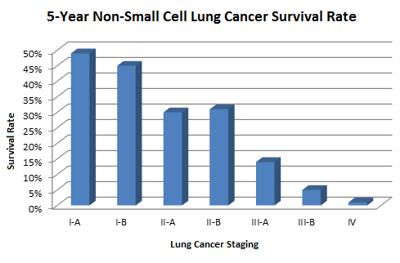
More Numbers, more information
The most recent lung cancer statistics show the overall five-year survival for lung cancer is 16 percent — that is, 16 of every 100 people diagnosed with the disease will still be alive 5 years after diagnosis. (cancer.gov)
These other stats say that if a person is diagnosed at Stage IV, his/her chances of being alive after 5 years is less than 5%, and if he/she was diagnosed at Stage 1A it is more than 45%
You would want to know.
Notes:
My father died of NSCLC a few years ago. In early 2010 he was diagnosed and told he had a couple of months to live. He lived until November of 2013 and for most of that time felt that the chemo had the greatest negative effect on his quality of life.
My mother has breast cancer that has metastasized into her spine and skull. Once her spine was glued back together, she has not suffered from this. We (Mother, sister, and I) have been expecting her to die in a month for 2 years now.
The doctors don’t seem to know how to tell patients anything other than the average result for stage IV cancer. They have one script “You have Stage IV cancer. It has penetrated in multiple places in your body and we can’t effectively treat it. You should assume you will die in around 2 months.”
Would you want to see these charts? I would if I were diagnosed with cancer. I’d want to see all the data analysis with other factors (age at diagnosis, general health at diagnosis, etc.)

Slide 5
Don’t sweat the small stuff: Is this the small stuff?
People often worry about unlikely events.
People are often surprised by undesirable outcomes when they have tacitly accepted a risk.
Practice developing a sense of probability and probability distributions of various events and conditions you will encounter.
Accept the things you cannot change, and the things that aren’t worth dealing with
Make the changes that will have an impact.
Notes:
On the other hand, sometimes we worry when we don’t need to. Enough that someone could write a book “Don’t Sweat the Small Stuff” with the subtitle “And it is all small stuff”
I don’t think you should assume it is all small stuff. I think you should use your common sense, your values, and your analytical tools to make choices about what you will sweat about, to the extent that you can.
Stress is bad for you.
Bad stuff happens. Bad stuff happens even to good people.
Worry about car crashes more than plane crashes. Drive defensively and mindfully, and expect that from others driving you and your family.
Worry about flu more than Ebola or mutant virus variants. Flu kills more people. It hospitalizes more people. And you can greatly reduce your risks with a shot.
Don’t worry about shots.

Slide 6
The Law of Large Numbers
The strong law of large numbers states that the sample average converges almost surely to the expected value.
The weak law of large numbers states that the sample average converges in probability towards the expected value.
Not much help when the numbers aren’t large!
Notes:
People sometimes excuse using averages only, and not other characteristics of a distribution by claiming application of the law of large number.
You aren’t a large number.

Slide 7
About the Central Limit Theorem
Take any population, whether it's normally distributed or not. Randomly select at least 30 members from that population, measure them for some characteristic, and then find the average of those measures. That average is one data point. Return the samples, select another random sample of the same number, and find the average of their measures. Do the same again and again. The Central Limit Theorem says that those averages tend to have a normal distribution.
Notes:
Another excuse is the Central Limit Theorem.
It really just says that if you take a bunch of non-small samples, and take the averages of those samples, the averages will be normally distributed.

Slide 8
Bell Curve, Gaussian Distribution, Normal
Normal distributions are symmetric, and the mean, median, mode are all the same point.
Normal is usual. For a single population we get a graph like these.
Many animals (including people) have a strong sense of normal and will reject individuals with observable characteristics that differ too much from the central tendency. People can recognize a non-normal result from familiar processes.
Notes:
Lots of things are normally distributed. This is my big tip for your thinking. Normal is normal.
Things that seem just wrong somehow probably fall more than 3 sigma away from the mean, and depending on the breadth of your experience may be beyond that and represent “out of control” for the process.
People who are “different” get picked on.
Chickens (free-range) who are “different” get pecked to death.

Slide 9
Average temperature, normal for here.
Fairfax County
These are normal temperatures across the shaded widths.
Radio stations and newspapers use the averages and call them normal.
We don’t actually get “average” temperatures very often.
We get “normal” temperatures all the time.
Notes:
I hope you can see (but you probably can’t) that the bands have a central solid line, and 2 zones of shaded area outside the line. The line is the average high, in red, and the average low, in blue. In winter months, the shading is wider than in summer, so the range of normal for the highs and lows is greater. The average high on Jan 17 is 40, normal high is anywhere from about 28 to 55! Lows are normally between 10 and 32, averaging 24.

Slide 10
Not Normal may be Expected
Poisson Distributions describe occasional, independent, events.
Soccer goals
Calls to a call center
Radioactive decay
Overflow floods
The horizontal axis is the index k, the number of occurrences. λ is the expected value. The function is defined only at integer values of k. The connecting lines are only guides for the eye.
By Skbkekas - Own work, CC BY 3.0, https://commons.wikimedia.org/w/index.php?curid=9447142
Notes:
This is one of many nice examples of probability distributions from Wikipedia.
Poisson distributions are a natural distribution that isn’t normal, but is very useful for modeling things like capacity planning, queuing.

Slide 11
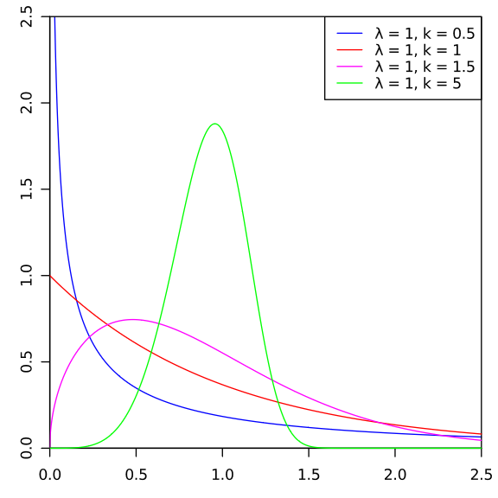
Not Normal may be Expected
Reliability engineering uses bathtub curves.
Failure rates over a product life
Reliability engineering also uses Weibull Distributions
By Calimo - Own work, after Philip Leitch., CC BY-SA 3.0, https://commons.wikimedia.org/w/index.php?curid=9671814
Notes:
As I mentioned in the beginning, reliability engineering uses probability distributions to help predict failure rates, and defect detection.
The “average” failure rate of the items would be somewhere in the blue curve. That doesn’t help you know that if your item survives the “infant mortality” stage that it may very well last until it wears out.

Slide 12
Thinking in distributions
Political predictions are all using distributions
Candidate X is ahead of Candidate Y 28% to 23% with voters 18 to 24
The average women’s shoe size
American women average size 8
Companies don’t make just the average size.
Notes:
Now I know why I’ve had trouble finding 9 and a half. I’m glad I’m not looking for 11.5

Slide 13
Ask yourself – critical thinking
Are you limiting your information by thinking in averages?
Are you missing something important?
Is someone limiting the information you are getting? Intentionally?
Did they weigh salmon that weren’t caught? Is this only adult salmon, spawning salmon, legally caught salmon (so no one reported the small ones?)
Notes:
I’m pretty sure salmon start out really small. They come from salmon eggs.

Slide 14
Resources and recommended reading
Probability Distributions
Wikipedia – not supposed to contain original content, but has some of the best write ups on various distributions and applications of them
Critical Thinking
Paulos, John Allen, A Mathematician Reads the Newspaper , Basic Books, 1995

Slide 15
Summary
Benefits of probability distributions instead of single values.
Better representations of reality for forecasting
Provide more information for decision making
Individual acceptance
Examples of probability distributions instead of single values
Normal examples
Examples with other distributions
Critical thinking refresher, too.

