Slide 1
ASQ Sections
“The Bedrock of ASQ”

Slide 2
To Our New Members & Guests…
Hey there! Hi there! Ho there! You’re as
as can be!
We’re glad to have you!

Slide 3
ASQ Organization
World Headquarters
Milwaukee, Wisconsin
Founded 16 February 1946 (Saturday) to
Maintain quality gains of World War II
800-248-1946 (note the founding year as last 4)
Divisions – The Backbone of ASQ
27 Quality specialty practices
Strong interface with industry & manufacturers
Sections – The Bedrock of ASQ and Members
Local connection with other quality professionals
Over 300 sections across North America

Slide 4
Section Organization
25 Regions across the world
1 Director (volunteer) for each region
Director can serve 6 consecutive years
Have considerable Section experience
Regions are subdivided into Sections
Numeric Coding (RRSS)
Section 0511
05 – Region
11 – Section
Numbers sequentially assigned as each section is created

Slide 5
Sister Section Locations (05nn)
00 Lehigh Valley, PA
01 North Central, PA (State College)
02 Baltimore, MD
03 Harrisburg, PA
05 Philadelphia, PA
06 Delaware (only 3 counties in entire state!)
08 Southern New Jersey
09 Washington, DC and Suburban Maryland
10 Reading, PA
11 Northern Virginia (outside Washington, DC)
12 Del-Mar-Va (Delaware–Maryland–Virginia triangle)
04 & 07 <Open because they ‘collapsed’ from significant membership loss and no volunteers to run section>

Slide 6
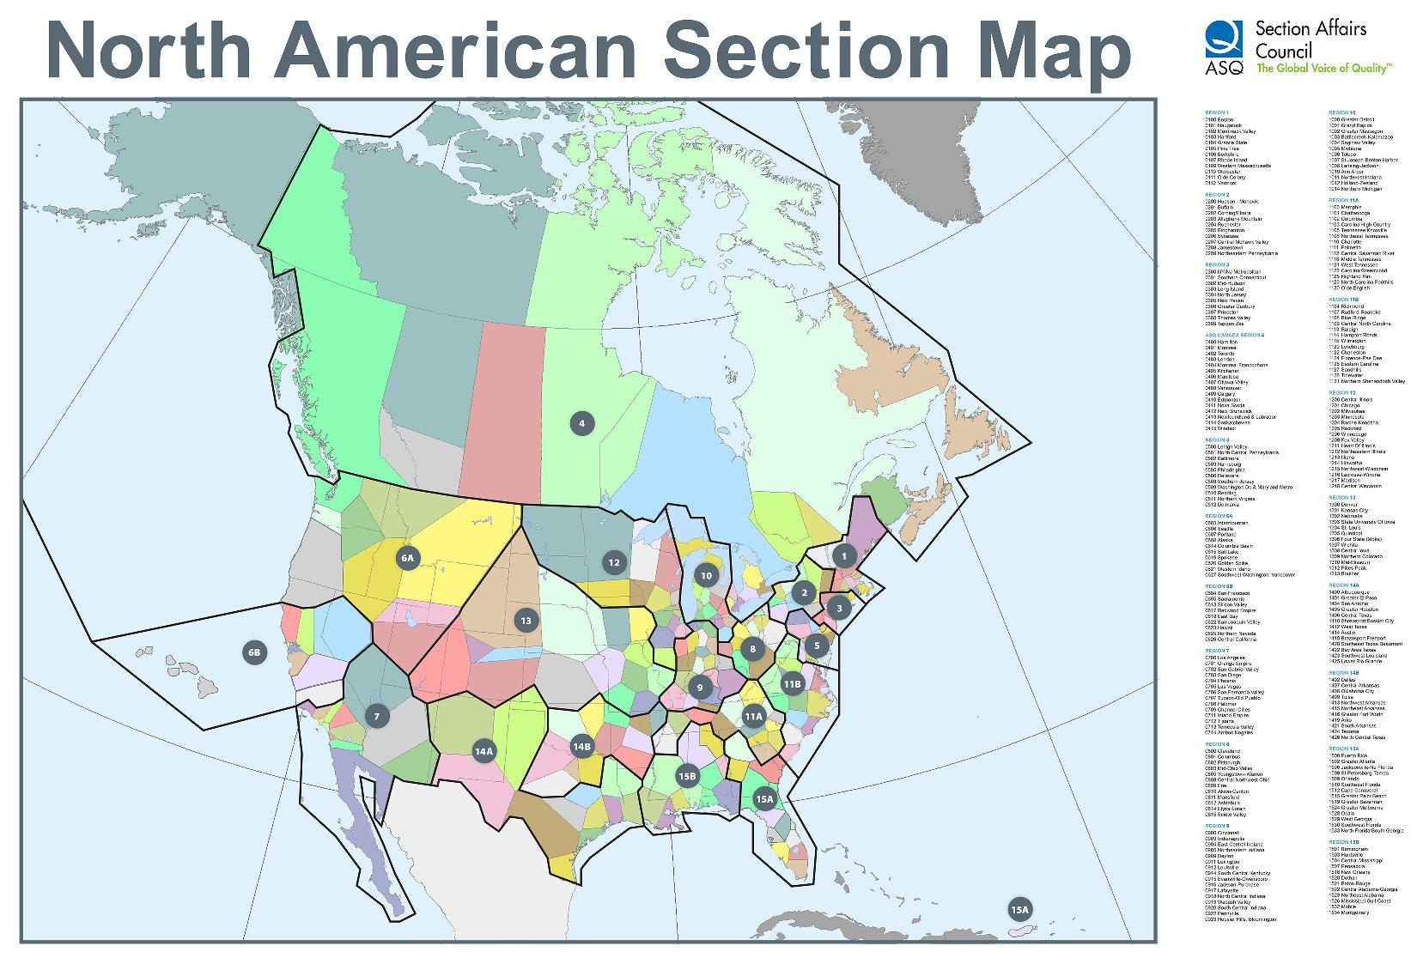
United States & Canada

Slide 7
Section 0511 Origins
Emerged from the ultra large Section 0509
Metropolitan Washington, DC geographic area
1,500+ Members before reapportionment
Washington, DC with adjoining Maryland and Northern Virginia suburbs
W. Edwards Deming, PhD led its creation in 1982
Dr. Deming wanted a dedicated Northern Virginia Section closer to his Herndon residence and home office
Brought in colleagues like Dr. Joseph Juran
We still use his originally section established Herndon P.O. Box!

Slide 8
Section 0511 Original Benefits
Access to National and International experts
Meeting speakers (from Deming’s rolodex)
Networking
Convenient way for quality professionals to meet monthly on the way home from work
…these benefits continue to this day!
“We maintain the ‘Deming Flame Legacy’ while pioneering new frontiers and vistas in quality”

Slide 9
Section 0511 – Factoids (1 of 2)
5 Northern Virginia Counties – 1,582 Square Miles
Arlington
Fairfax
Loudoun
Prince William
Stafford
We rotate monthly meeting venues East-to-West-and-back-again so as to reach-out into member neighborhoods and work places
Membership – 571

Slide 10
Section 0511 – Factoids (2 of 2)
2nd Wednesday of each month is our Monthly Dinner Meeting with a Presentation Speaker
We provide professional networking and job lead opportunities
We provide ASQ Certification Exam preparation training classes throughout the year
We provide young professional mentoring and opportunities

Slide 11
Section 0511 Board Members (1 of 3)
Elected Officers
Chair (CEO) – Gregg Monaco
Chair Elect (COO) – Melissa Cicotello
Secretary – Barbara McCullough
Treasurer* – Cyndi Reichart (Jan 2016–Dec 2017)
Past Chair – John Mullins (Retired)
* Term Limited by ASQ Articles of Incorporation
Others can serve as long as 6 years, provided they are re-elected
Chair Elect must have some kind of Section “Chair” experience for ‘context and success’ within our section

Slide 12
Section 0511 Board Members (2 of 3)
Appointed Chairs
Arrangements
Database / RU tallies – Bob Orkin
Venues – Carolyn Miller
Audit – Charlotte Wild
Education – Paul Mills (retiring)
Muzaffar Zaffar (incoming)
Finance – Mike Coleman
Historian – Connie Broadie
Lean Six Sigma SIG – Kristine Hejna
Membership – Mike Coleman (Moving, Need backfill)
Nominating – Gregg Monaco

Slide 13
Section 0511 Board Members (3 of 3)
Appointed Chairs (Continued)
Placements – Seema Garg
Programs – Jim Pastorick
Recertification – Christine Kurowski
Software SIG – Kristine Hejna
Testing Proctor – Eric Jensen
Treasurer Elect – Sara McAlpine
Voice of the Customer – Jai Singh
Web / Internet Liaison – Jeff Parnes
We Welcome Volunteers!

Slide 14
Certification Exams (18 Certifications)
Series 1 –
Feb – June - October
Biomedical Auditor
Certified Supplier Quality Professional
HACCP Auditor
Manager of Quality / Organization Excellence
Master Black Belt
Quality Inspector
Quality Technician
Reliability Engineer
Six Sigma Black Belt
Six Sigma Yellow Belt
Series 2 –
April – August – December
Calibration Technician
Pharmaceutical GMP Pro
Quality Auditor
Quality Engineer
Quality Improvement Associate
Quality Process Analyst
Six Sigma Green Belt
Software Quality Engineer
Exam matrix established by ASQ Headquarters

Slide 15
Rules of Thumb: Registration & Exam
Registration 2nd Friday of:
October 14 for
December 12 for
Prometric CBT Exam: *
December 1 – 15
Series 2
Feb 1- 15
Series 1
Changes pending given new CBT paradigm
2017 Initiates 6 Exam Cycles
Exam re-takes possible in 60-days
Note: Extra Fees $ Apply for Late Registrations

Slide 16
ASQ Exam Dates
Effective September 2016
ALL exams are Computer Based Testing (CBT)
Exams are available Monday–Saturday
There will be “time bounds” on when exams are available
Register through ASQ (Same as Always)
2-Month wait for “re-tests” (not 6)
Prometric is the CBT vendor
Schedule directly for a reserved test seat with your Prometric Center of choice (extra step & separate from ASQ registration)
Separate Prometric “seat fee”
ALL NEW

Slide 17
ASQ Exam Prep Classes
December 1-15 Exams
CQA (in-progress via web)
2017 Exams (Feb – Apr – Jun – Aug – Oct – Dec)
Series 1 Exams (Series 2 re-takes)
Series 2 Exams (Series 1 re-takes)

Slide 18
Certification Renewals
ASQ Certifications MUST be renewed every 3 years
Work with the Recertification Chair
Recertification Units (RU) earned by:
Working in your specialty area
Attending monthly Dinner/Program meetings
Developing courseware / Delivering courseware
Serving in a Leadership position (any level)
Special Interest Group (SIG) participation
And many others

Slide 19
Recertification
Contact Recertification Chair
Recertification16@asq0511.org
Follow our Website Recertification Notes and Guidelines. Results in:
Faster processing
Minimizes returns of packages for corrections
Recertification Chair does not edit apps
Recertification Chair cannot change, edit, modify, or make exceptions to your due date
Most prolific renewal months
June
December

Slide 20
Special Interest Groups (SIG)
Section 0511 participates with Section 0509 and local IEEE Chapter in
Software Developer SIG
4th Tuesday of the month
Lean Six Sigma SIG
4th Wednesday of the month
Venues alternate – mostly McLean & Vienna
Pizza and soda menu (typical)
Guest speaker is an expert from SIG field
0509, 0511 & IEEE alternate sponsoring speakers
Great synergy and networking with highly focused peers

Slide 21
Bio-Med/Bio-Tech SIG
Every other Thursday
www.asq509.org for meeting info
Register by Noon of the meeting date
Free to ASQ members (Non-ASQ is $5)
I-270 Corridor (Maryland)
Bethesda / Rockville exits
Pizza, soda & beer menu
‘Bio Expert’ guest speakers
Often hold 2 or 3 doctorate specialty degrees
Great synergy and networking
This is one of the most robust SIGs in America
75+ attend / Job leads in things “bio”

Slide 22
Our Section Innovations
Web-delivered certification course training
Video recording and archiving of dinner meetings
Cloud data storage
Smart Phone friendly web site rendering
Section Leadership Position descriptions
Complimentary Operating Instructions
Work break down structures (WBS) by position
Virtual bank administrative coordination

Slide 23
Impact Beyond Northern Virginia
Section 0511 is known for providing:
ASQ World – Presidents
ASQ World – Board of Director Members
Division Leadership across 27 specialties
Special project focus at ASQ and Division levels
“We Channel the Spirit of Deming”

Slide 24
Upcoming Conferences (1 of 1)
International Conference on Quality Standards
Nov 14-15 – Pittsburgh, PA
Lean and Six Sigma
Feb 27-28, 2017 – Phoenix, AZ
Quality in Space and Defense Industries
March 13-14 – Cape Canaveral, FL

Slide 25
Advance Conference Planning
ASQ World 1-3 May 2017
Charlotte, NC
“The City of Frescoes”
Fairfax, VA to Charlotte, NC (Driving)(I-95, I-85, I-77)
390 Miles 6 Hours 14 Minutes
Airline: ~1 hour 20 minutes ($228 – $659 Roundtrip)
Dulles | Reagan | BWI to Charlotte (CLT)
American (4,700+ flights) United (1,100+)
Delta (4,000+) Jet Blue (500+)
These airlines service CLT and include all their city-pair flight opportunities

Slide 26
Advance Conference Planning
ASQ World 2017
Family & Fun Time
Carolina Panthers: Bank of America Stadium Tour
Charlotte Hornets: Warner Cable Arena Tour
Dinosaur Alive!
Planet Snoopy
CaroWinds Amusement Park (Carolina Winds)
Carolina Aviation Museum (Sully’s ‘Miracle on the Hudson’ Airbus)
More pending
Biltmore Estate (Ashville) 124 miles; 2 Hours 9 Min

Slide 27
SIG Meetings
Software SIG – 4th Tuesday
Includes Section 0509 and IEEE
November 29
Patrick Henry Library, Vienna
Lean Six Sigma SIG – 4th Wednesday
Includes Section 0509 and IEEE
November 30
Teknology Corner, McLean

Slide 28
Next Section 0511 Dinner
December 9 – On The Border
Reston
Social Event

