Slide 1
Joshua Wilson
November 9th, 2016

Slide 2
We Are A Local Company
Bonded
Local Company
Manassas, VA
Insured for $2 Million ( Residential)

Slide 3
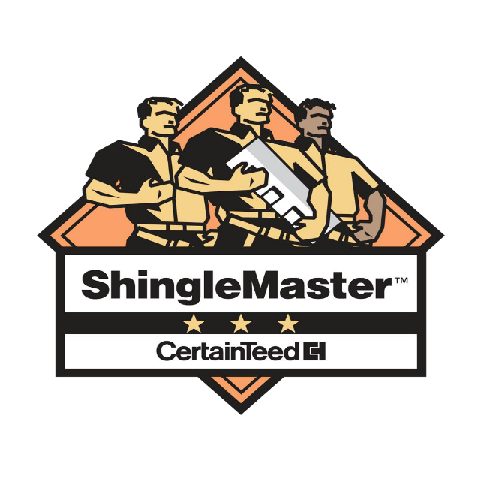
Credentials and Ratings
HAAG Certified
BBB – An “A” Rating
NRCA Member
Personally handling claims for four years
Hundreds of claims worth of experience

Slide 4
Role of a Project Manager
I provide the initial inspection for eligibility
I advise the Homeowner on steps to take if any
I meet with the insurance company’s representative on behalf of the insured.
I advocate for correct pricing
I come to a settlement for the insured to complete the project for the agreed price with the insurance company.
I invoice the insurance company accordingly to the agreed settlement.

Slide 5
Insurance claims process
Inspection
File claim
Meet adjuster
Supplements / mortgage company – items missing from insurance claim get the check signed by the insurance company.
Complete work (timeline depends on Trades and complexity)
Collect checks
Invoice insurance company
Collect final checks

Slide 6
Roofing Replacement Process (Residential)
When a roofing System is replaced there are certain steps that need to be taken throughout the process.
The roofing Materials are disposed of in the dumpster provided.
Every single old nail is removed from your decking
All decking is inspected to be re used.
The new felt is laid out as well as the ice and water shield.
The roofers should chalk lines out for the shingles to be laid.
The roofers are finally able to install per shingle manufacturer guildlines.
Once the Roofing system is installed proper caulking is added to penetrations of the roof for protection.

Slide 7
Technology of a Roofing System
A Roofing System is comprised of a few items and extra labor that is expected.
15# & 30# Felt – allows moister to escape roofing system.
Shingles – Sheds water from the home
Drip edge – Not required by law – Helps the Roofing system shed water on the edges
Ice & water shield – Prevents Ice Damning from damaging your Decking on the eaves and valleys
Flashing – A flashing is any metal or plastic that covers any penetration or exposure on your roof. Normally what we would call a Pipe flashing. A boot is installed over a pvc pipe that penetrates your roofing system for ventilation.

Slide 8
Different types of ventilation.
There are a few different types of ventilations for a roofing system.
Gable vents.
Ridge vent.
Power attic Fan
Box vents
Exhaust vents

Slide 9
The dangers of handling an insurance claim
Too often homeowners are set back from financial gains of restoring their homes and it is normally the result of ignorance of the process and how to negotiate.
Negotiating with insurance companies is a toss up. There are many different types of negotiations that take place from each insurance company and that’s just one part of the battle.
Understanding how each insurance company negotiates is just a small battle compared to understanding how to use the Third party pricing software they use to compare pricing that can also vary from each insurance company.
This is why when you are filing any type of homeowner’s claim it is important to have a contractor that is experienced with insurance claims.

Slide 10
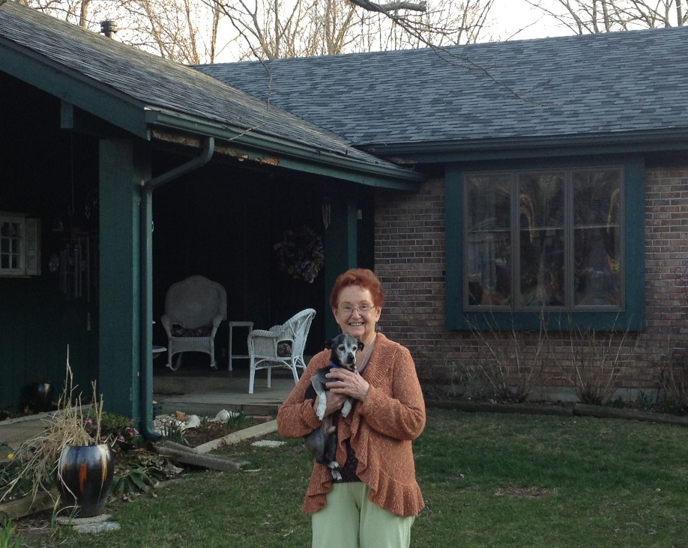
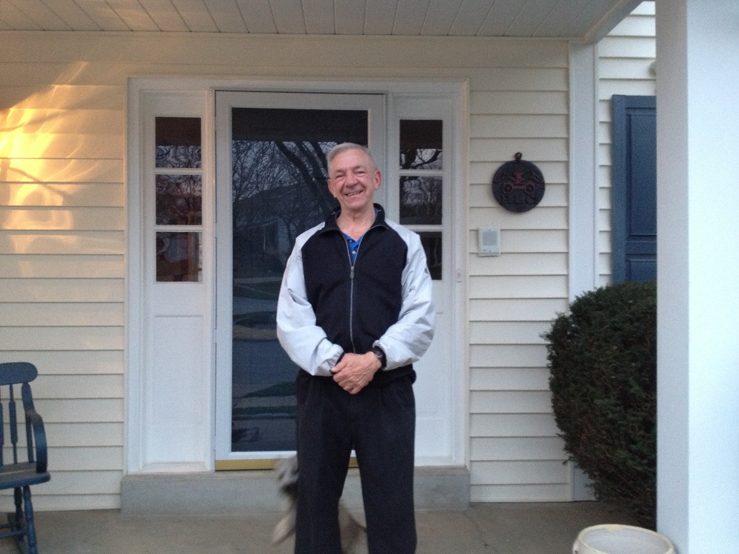
How We Set Ourselves Apart
Follow Through and Education
Fight for our customers
Maximize Claims Negotiations
Provide Quality Work
Communication is key
A thorough understanding of the process
Millions in experience
An honest approach

Slide 11
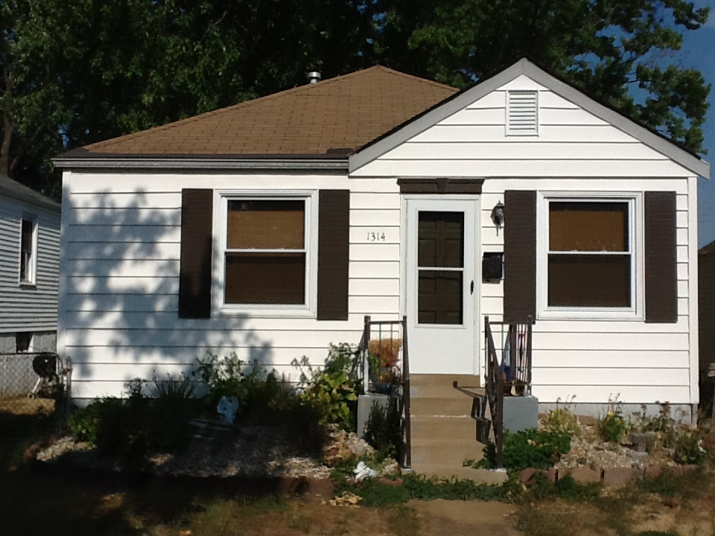
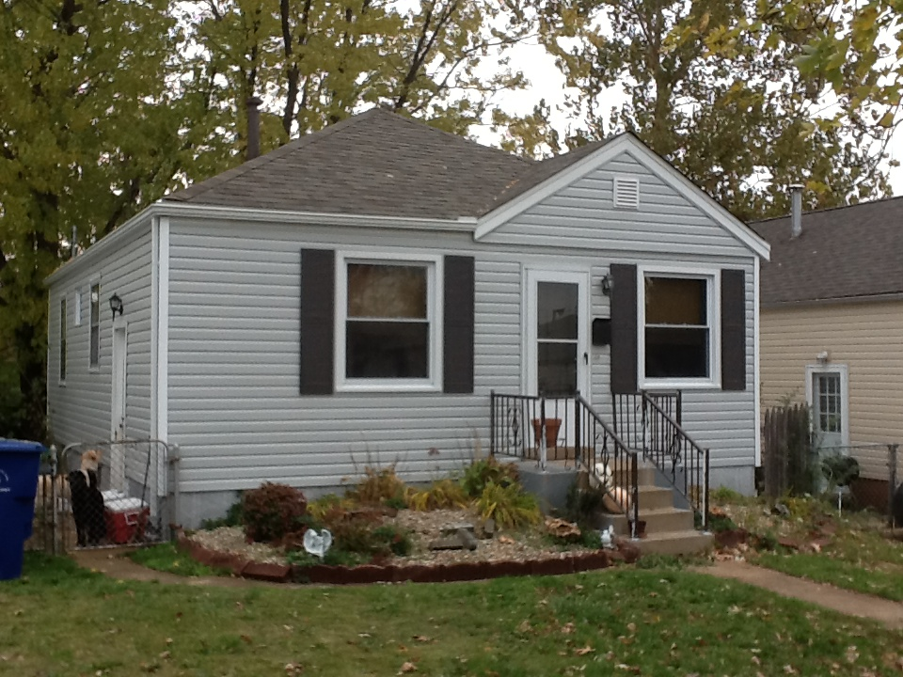
The Work!!!
Before After

Slide 12
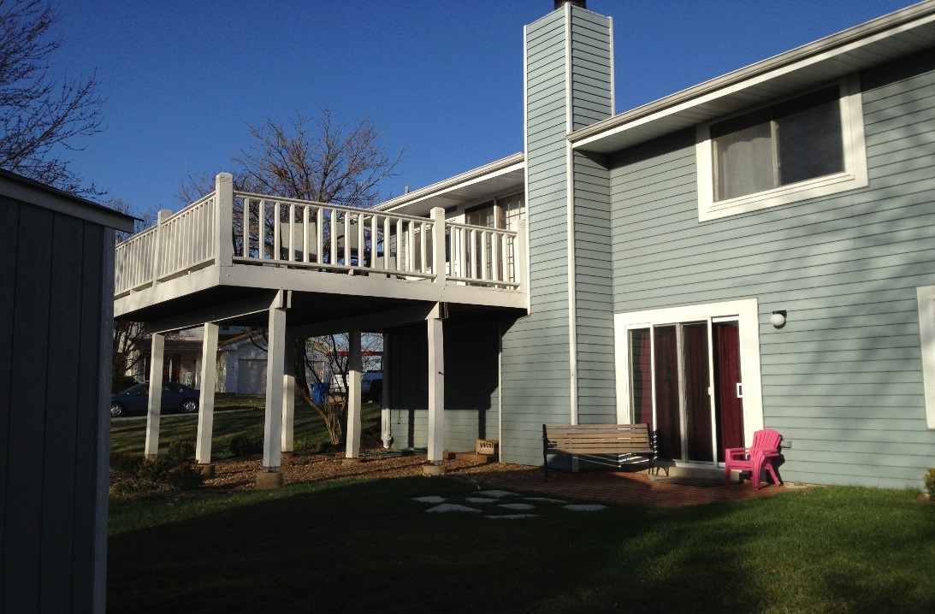
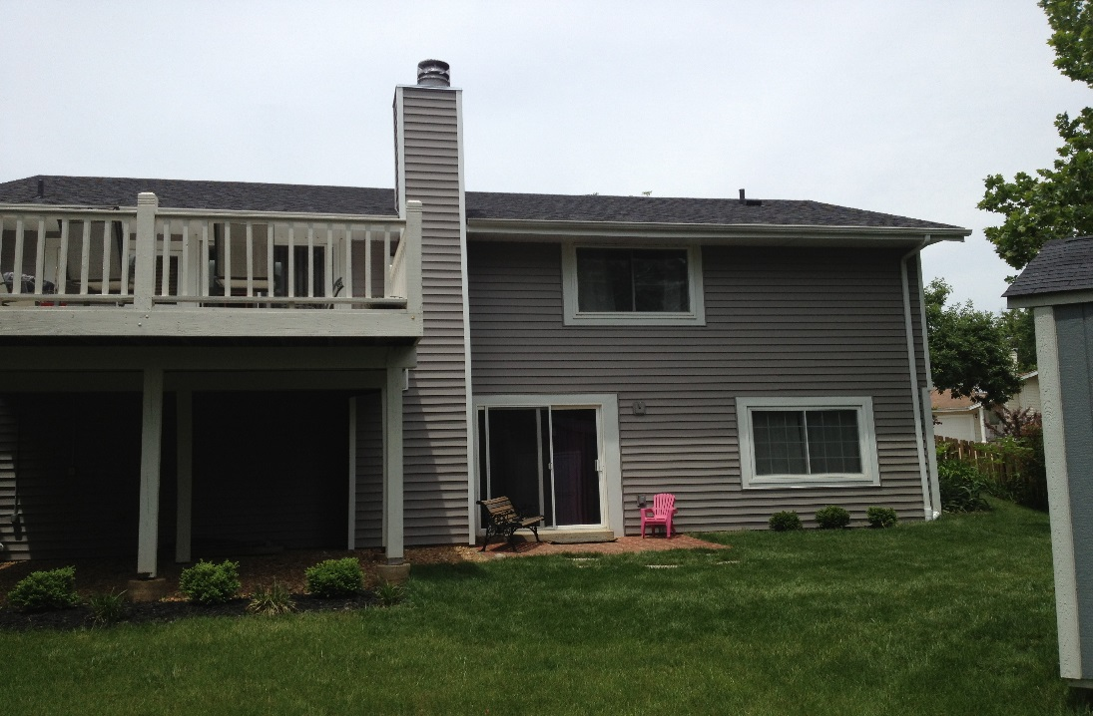
More!!!
Before After

Slide 13
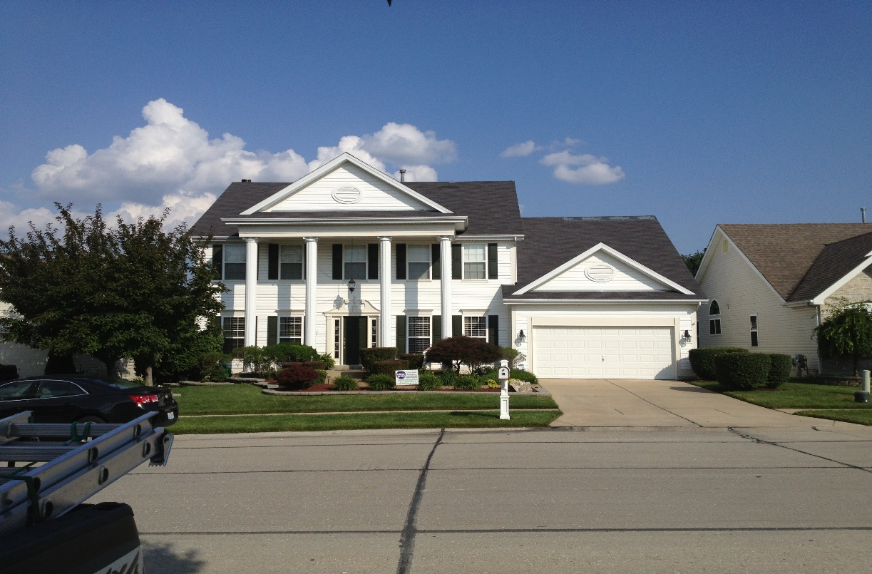
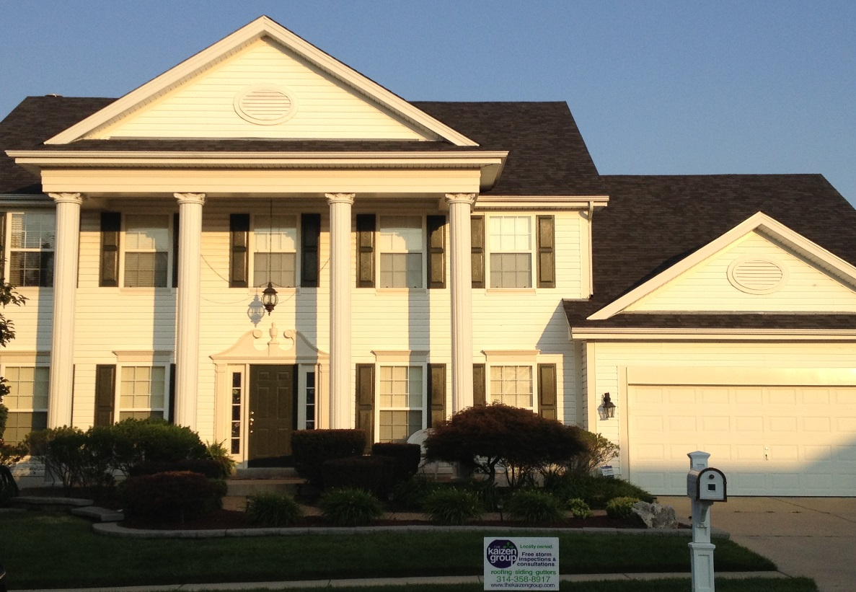
Annnnd More Pics!!!!
Before After

Slide 14
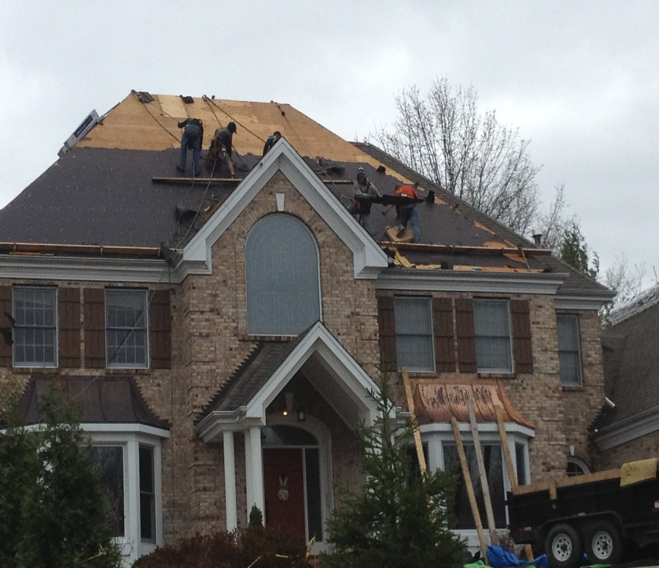
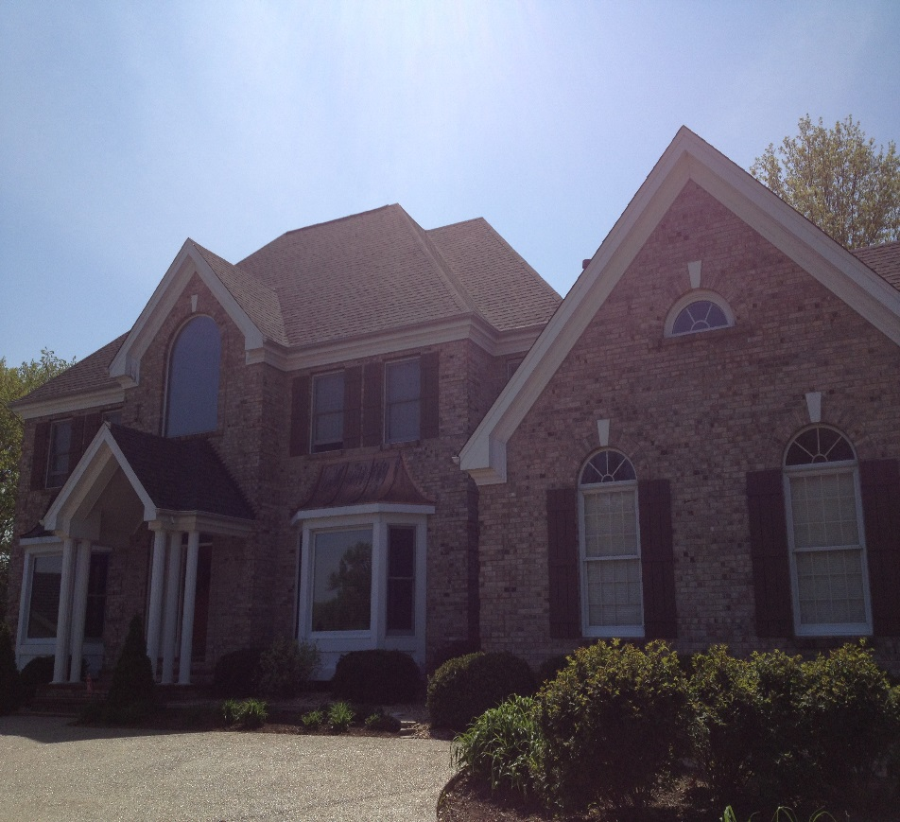
Annnnnnnnd Even More!!!!
Before After

Slide 15
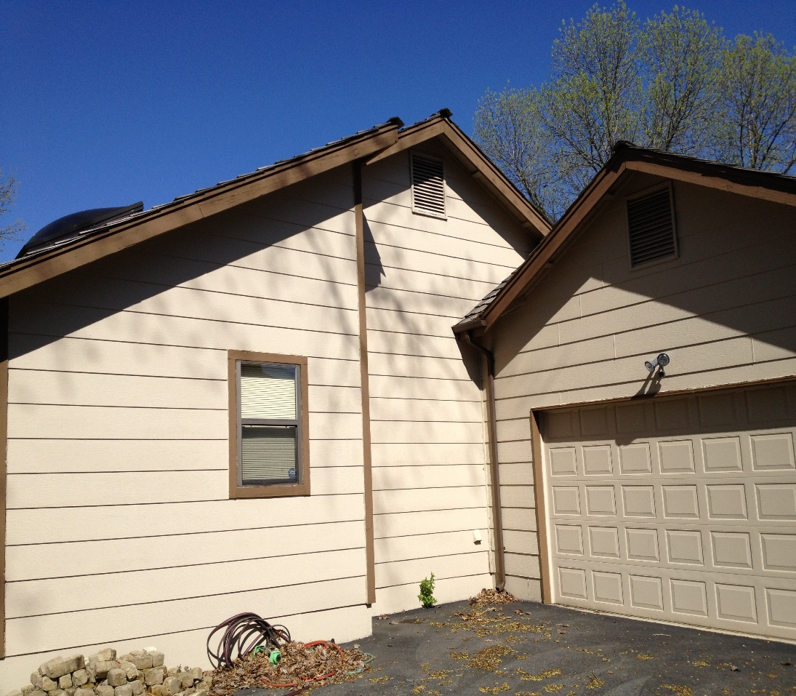
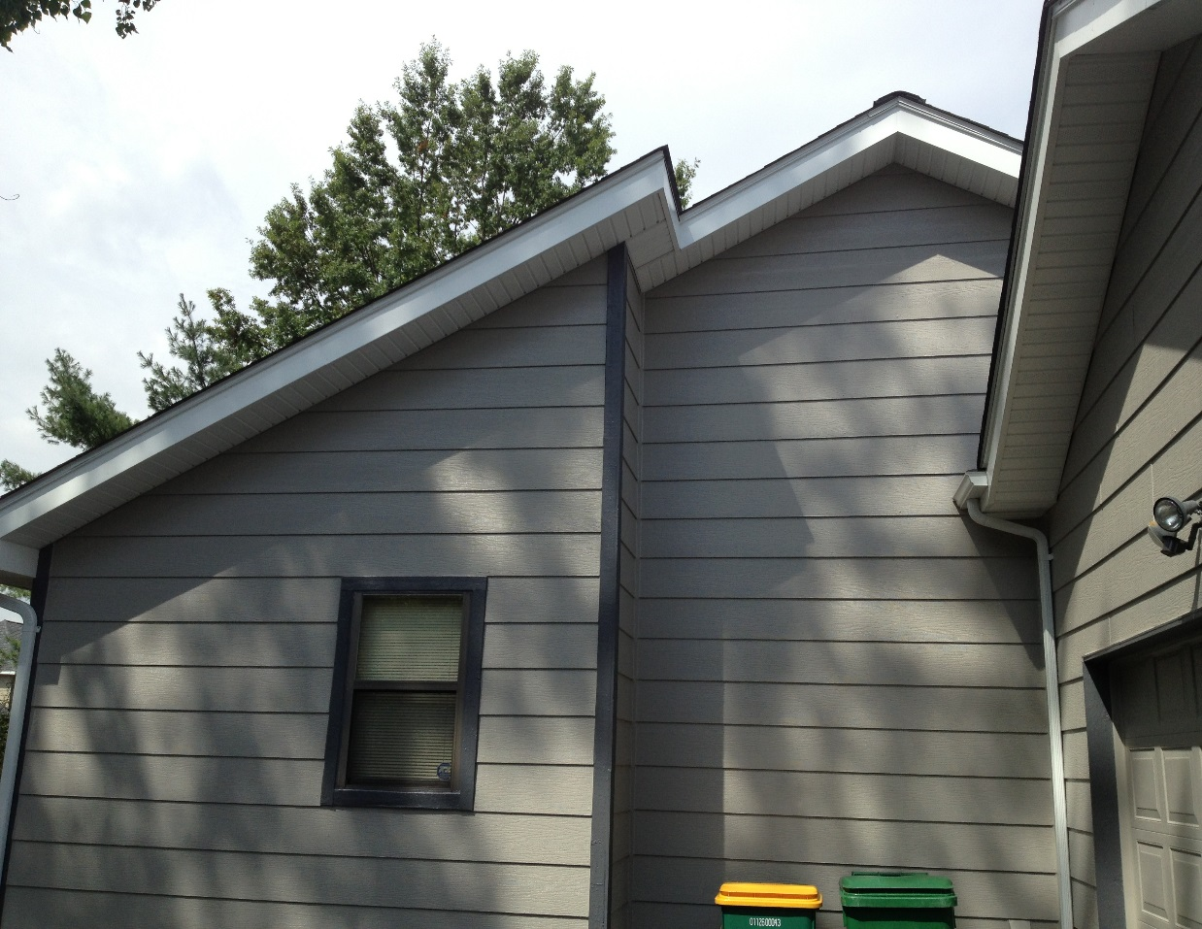
OMG, more pics!!!
Before After

Slide 16
PEOPLE WHO ARE GREAT FOR ME
Property investors
People who use real estate as a source of revenue
Property management companies
Apartment complexes
Commercial buildings
Maintenance programs

