Slide 1
ASQ World Conference on Quality and Improvement
May 1-3, 2017
Grow Your Influence

Slide 2
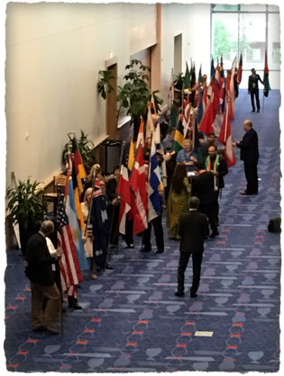
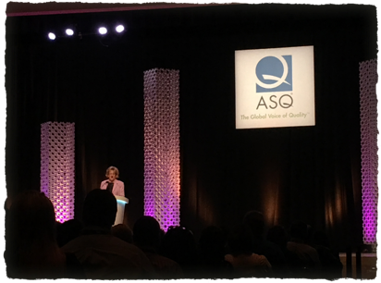
Welcome to Charlotte, North Carolina!

Slide 4
Fun In the Photo Booth

Slide 5
Team Excellence Awards
All through the first days at the conference the teams from all over the world were making their final presentations. We ate lunch with two of the women on the Molinos team and they actually won 3rd place with their poster. They were super excited. They came to the conference from Argentina and for some, it was their first time in the U.S. Their poster is #3 on the next slide.

Slide 6
#3 won 3rd place in the competition.

Slide 8
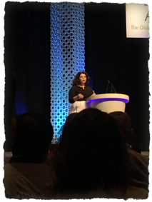
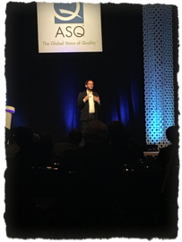
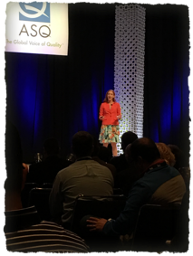
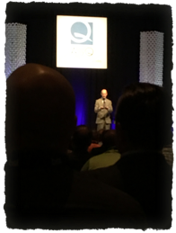
Excellent Speakers
Jeremy Gutsche
There were five keynote speakers and each was unique in their approaches to quality and the innovative ideas they brought to us.
Jeremy runs TrendHunter.com.
Sebastian is widely known for his TED talks on data analytics.
Celeste is an award-winning journalist and Public Broadcasting host.
Geoff is Sr. Editor-at-Large for Fortune Magazine
Kelly is a psychologist and Stanford Graduate School of Business lecturer
The speakers that ASQ brings to the conference are of the highest quality and never disappoint.
Celeste Headlee
Sebastian Wernicke
Geoff Colvin
Kelly McGonigal

Slide 10
Networking at the NASCAR Hall of Fame

Slide 11
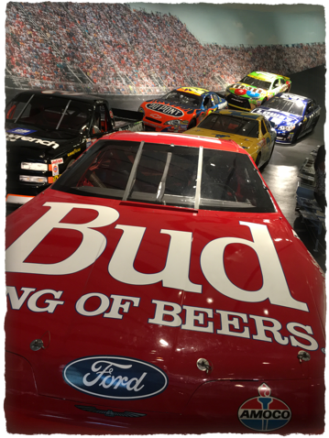
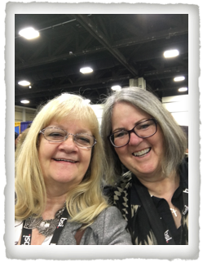
Barb and Cyndi

Slide 12
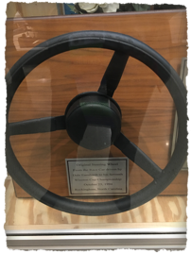
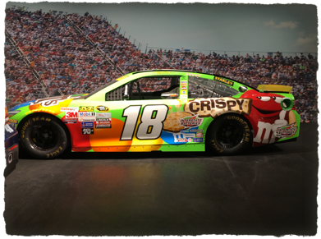
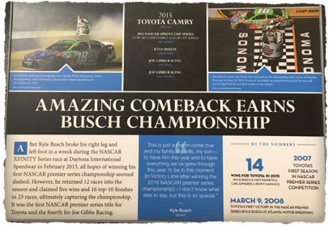
NASCAR
Hall of Fame

Slide 13
After 5 Sessions
Every year the conference offers After 5 Sessions for those die-hards who want to keep learning and do something fun even after all the great sessions and workshops are done.
This year they had:
Juggling for Creativity and Teamwork – Cyndi attended
Fun Tools to Enhance Problem-Solving Thinking
Well-Being: Your Unique Journey to Success
Living Responsibility: Incorporating SR into Daily Life
Unleashing Creativity – Barb attended

Slide 14
Next Year’s Conference
will be in Seattle, Washington
April 30 - May 2, 2018
If you would like to earn a ticket to the conference, the call for conference reviewers and moderators has already been put out. Go to the ASQ site and then go to the 2017 WCQI site. On the bottom right there is a button “2018 Call for Reviewers” (closes 11:59 PM EST on Friday, July 7, 2017)
https://www.conferenceabstracts.com/cfp2/login.asp?EventKey=IEEETGIT
Just request an access code, fill out your profile information, then fill out your application with your ASQ member information, the divisions and forums and areas of expertise that you possess.
Be patient, because you will probably not hear anything from the technical committee until August. Reviews are assigned then and have to be completed by September 15, 2017.

