Slide 1
Biobanking and its Role in Research
Jai P. Singh
ASQ Section 0511 Presentation
January 10, 2018

Slide 2

10 Ideas Changing the World
1. Why Your Job is Your Most
Valuable Asset
2. Repurposing the Suburbs
Survival-Store Shopping
Biobanks; Saving Your Parts
Need Land? Rent-A-Country
The New Calvinism
Ecological Intelligence
Amortality; Forever Young
Africa; Open for Business
Reinventing the Highway

Slide 3
Biobank........
A Biorepository is a biological materials repository that
collects, manages, processes, stores, and distributes
biospecimens to support scientific investigations……..
A building (conservation facility), room, or container for long
term storage for biological specimens either for Clinical or
Research purposes………….

Slide 4
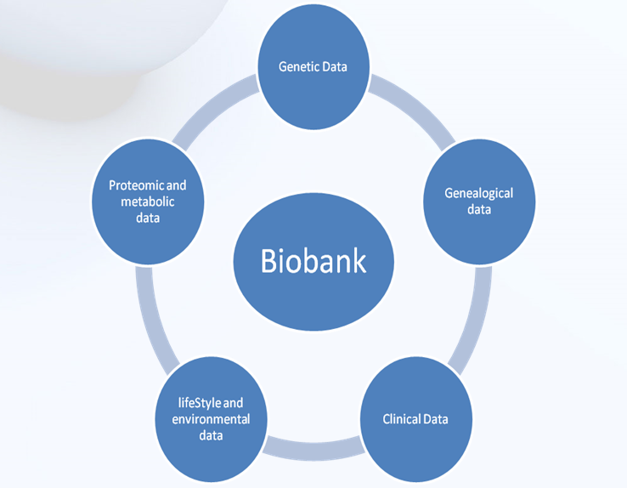
Biobank

Slide 5
Public Awareness: Patients, Volunteers
Internet Forum, Seminars, Research Presentations
TV/ Radio, Billboards, Public meetings/education
Understand the purpose of Biobank
Effective Participation in Biobanking
Fast consenting
No disruption of Clinical Workflow or material
Effective BioBanking

Slide 6
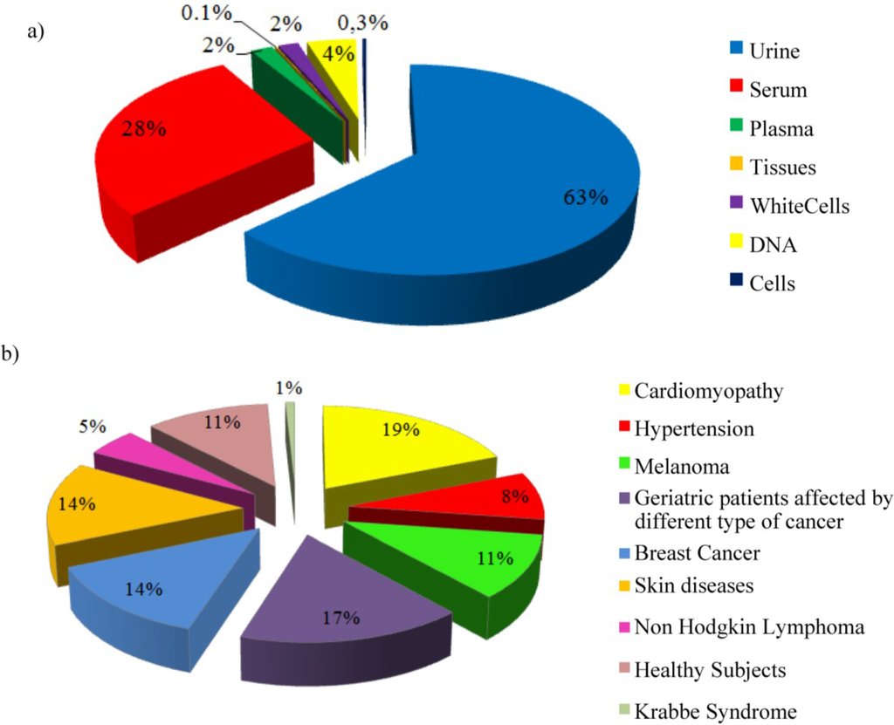
Sample collection Type and Different Diseases

Slide 7
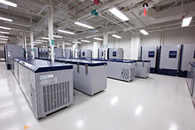
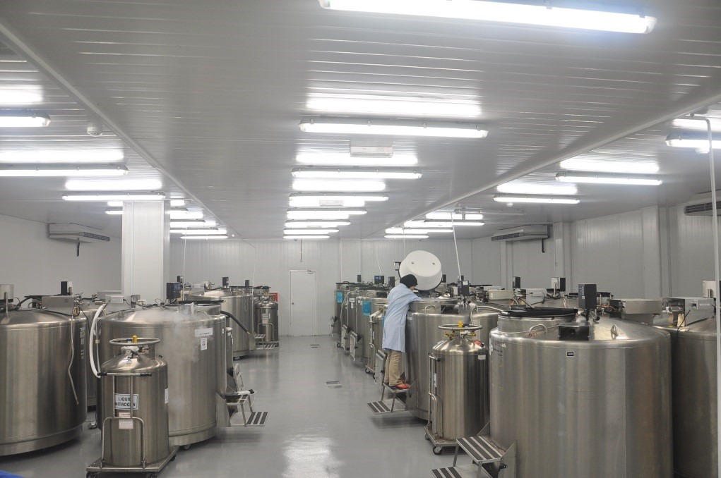
Freezers (-80 ͦ C) and Liquid N2 (-196 ͦ C)

Slide 8
Biospecimen are collected for Patient Care and for Research
Biospecimen Collection
Biospecimen Processing
Patient Care
Clinical Trials
Research
Biospecimen Storage
Biospecimen Analysis
Clinical Data Collection
Seed Vault/Storage

Slide 9
Translational Research Will Lead the Way to Personalized Medicine
Molecular Data
Diagnosis / Therapy
Translational Research
Personalized Care
Biospecimen Analysis
Biospecimen Collection and Storage
Biospecimen Processing and Banking

Slide 10








Lifecycle of the Biospecimen
Specimen is viable
and biologically reactive
Molecular composition subject to
further alteration/degradation
Pre-acquisition
Post-acquisition

Slide 11
Biospecimen Availability and Quality:
Major Challenge for Research
The lack of high quality, appropriately collected, stored and annotated
specimen is the limiting factor for translational research or basic research
High quality specimen enables:
Drug discovery
Translational Research and basic research
Clinical development
Assay variability
Specimen variability
Diagnostic development
Personalized medicine
Targeted therapies

Slide 12
The Difficulty in Acquiring High Quality Specimens and Data?
Collection, processing, storage procedures differ
Degree and type of data annotations varies
Scope and type of patient consent differs
Access policies are lacking or unknown to potential users
Materials transfer agreement conditions differ
Supporting IT structures differ in capacity and functionality
Funding sources varies
Leads to Wide Variation in Quality of Specimen and Data

Slide 13
Pre-analytical Variables
Pre-acquisition variables:
Antibiotics
Other drugs
Type of Anesthesia
Duration of Anesthesia
Arterial Clamp time
Blood pressure variations
Intra-op blood loss
Intra-op blood administration
Intra-op fluid administration
Pre-existing medical conditions
Patient gender
Ethnicity
Post-acquisition variables:
Time at room temperature
Temperature of room
Type of fixative
Time of fixative
Rate of freezing
Processing method
Size of aliquots
Type of collection container
Biomolecule extraction method
Storage temperature
Storage duration
Storage in vacuum

Slide 14
Strategic Approach to Problem
STANDARDS: Develop guidance for biobanking to harmonize procedures for collection, processing, storage and distribution of biospecimens (The Best Practices for Biospecimen Resources: ISBER).
SCIENCE: research to better understand how pre-analytical factors affect the integrity of the biospecimen (Biospecimen Research Network).
Synergies: Collaboration to share resources and develop community-wide and international standards (CAP, FDA, NIST, National and International Partners).

Slide 15
Biorepository Services
Manage and Support functions
Managing Contracts for Storage
International Collaboration for Biorepository: Establish and Educate on Best Practices for Collection, Processing, Storage and Distribution of Biospecimen.
Maintain Compliance.
Work with European Partners
cGMP Biospecimen Storage Services: Government and Commercial partners.
Develop relationship with International and Domestic Biorepositories.
Clinical Trials Support Services

Slide 16
Contract Services and Management
Work with Government researchers or Private Translational Institutes and collaborate on Specimen Collection and Storage and Research.
Identify laboratories for specialized assay for research. Select laboratory and determine the process of procurement for their services.
Develop specimen processing scheme in collaboration with researchers/investigators and support the specimen collection, processing, storage and retrieval of specimen (Domestic and International).
Process specimen based on the requirement set in study protocol.
Develop protocol for initial collection of specimen at field sites. Select collection sites and collect specimen, process materials, schedule procurement of materials and shipment of materials to designated field sites.
Store specimen and manage inventory.
Shipping and receiving of specimen to and from laboratory.
Maintain laboratory under compliance.
Automation in specimen processing

Slide 17
Contract Process Flow
Project Process Flow
Project Director
Government COTR
PI
Subcontractor
Government Contracting Office
Work performed by Subcontractor
Assay Data
Project Completion
Payment

Slide 18
Challenges in Contracting Process and Solutions
Education and Awareness at all Levels of Government and Internal Management Team (Department, Legal and Finance)
Statement of Work
Finding Laboratory to Work on the Project (Competitive Pricing)
Develop Subcontract in Conjunction with Contracting Office, Internal Legal Office
Material Transfer Agreements
Shipment of Specimen and Manage Inventory
Receipt of Specimen and Maintain Inventory
Manage Subcontract and Subcontractor Performance
Automation
Communication
Decision making

Slide 19
Challenges in Contracting Process and Solutions……
Working with International Subcontractor
  Communication (develop understanding)
  Education on subcontracting process
  Education on best practices
  SOP development: specimen collection, processing and storage
  Specimen collection, processing and inventory management
  Specimen Storage and distribution
  Temperature monitoring and record keeping
  Inventory management (system, support and record keeping)
  Payment structure (currency and price fluctuations issues)

Slide 20
Government Contract Activities and Report
Subcontract # | MEP # | Study/Res. | NCI- PIs | Status | Study Value $$
BRC-55502-23 (COA # 31) Johns Hopkins Univ. | 264 | Rakai Circumcision HPV/ Genotype | Charles Rabkin | Completed | $39,520.00
BRC-55502-17 (COA # 18): USC |  | Melatonin Assay | Ann Hsing Lisa Chu | Open | $63,294.00
BRC-55502-17 (COA # 18): USC | 266 | Prostate Tissue Study Hormones | Ann Hsing | Open | $181,623.00
BRC-55502-17 (COA # 18): US | 250 | Hormone Assay | Rebecca Troisi | Open | $44,400.00
BRC-55502-17 (COA # 18): USC | 287 | Hormone Analysis NIT study | Neal Freedman | Open | $87,296.00
BRC-55502-17 (COA # 18): USC |  | Ghrelin Assay | Neal Freedman | In-Process | $23,568.00
Subcontract with USC (NEW) |  | Hormone Assay: Mongolia | Rebecca Troisi | In-Process | $163,000.00
BRC-55502-22 (COA # 30): RAND | 237 | BioSpecimen | Jim Vaught | completed | $103,999.00
BRC-55502-28 (COA #40): Hershey Medical | 263 | Vit E; Smoking and Prostate cancer | Demetrius Albanes | Open | $97,096.00
BRC-55502-29 (COA #41): BioServe/Sandor (India) |  | DNA Extraction, SNP and storage | Rashmi Sinha | Open | $59,192.00
BRC-55502-31 (COA #44): Children's Hospital Boston |  | Hormone Analysis | Katherine McGlynn | Open | $178,699.00
BRC-55502-30 (COA #42): Lady Davis Institute, Montreal, Canada |  | Adipokines analysis | Roni Falk | Open | $49,755.00
Non-subcontract Work
Tecan Robot |  | Processing specimen |  |  | $250,000.00
Subcontract 17 & 27 | 202 | Dartmouth Twins | Troisi | Open
Non-subcontract | 228 | Lung Cancer in Women in China | Qing Lan Nat Rothman | Open

Slide 21
Commercial Storage and Management
Type of Biomateial and its requirement for storage: temperature, how long? How much?
Biomaterials are stored in vapor phase of liquid nitrogen. Cell banks are split (50:50) in two freezers
Bacterial cell banks stored in vapor phase of liquid nitrogen
Distribute biomaterials as requested ensuring proper temperature condition and maintain inventory
Provide Clinical Trial Support Services: Collection Kits, labeling, storage and inventory
Monitor freezer condition 24 hours a day by automated system and maintain records
Access to Biorepository is tightly controlled. Security is a high priority
Strategic development and grow commercial business
Redundant Systems (Generators, monitoring services)
Compliance (cGMP, EMA, FDA)

Slide 22
Streamlining the Process: Changes
Review process and incorporate changes:
  Develop interdepartmental communication (team based approach)
  Renewals and transfers
  Work with account managers (sales team)
  Added checks and balances in cell banking process flow: Cell bank directed by the end of production
  Work with order management (weekly meeting): Generate quotes and send to account managers
  Streamline cell storage paperwork acceptable to all accounts meeting quality and compliance
  Add Project managers into the process for support

Slide 23
Commercial Cell Banking Process Flow
cGMP
New Client
Quote Request
Cell Banks Produced
Elsewhere
Account Managers
Sales and Marketing
Existing Client
Renewal
Cell Banks Produced
Generate Quote per Bank
Send Quote to Client
Request for Renewal
Sent Annually
Cell Banks Released
Stored in Quarantine
IMT
Biorepository Forwards
T&C, Authorization, Security
to Client for Approval
Client Agrees to Store Cell Banks
at BioRepository
PO Received Entered
in Oracle
QA Approves Cell Banks
Client Agrees to T&C and forwards
Paper Work to Biorepository
And Sends PO Number
PO Entered in Oracle
Invoice Generated
for Payment
Sends Letter to Client
for Storage Authorization
90 Days Response Time
Bank Shipment for Storage
Scheduled
Manage Inventory
Follow Client Request
Payment Received
Client Response Received
for Storage
Bank Received at Biorepository
Labeled & Inventoried electronically
Maintain Communication with Client
Client Agrees to Store
Cell Banks stored

Slide 24
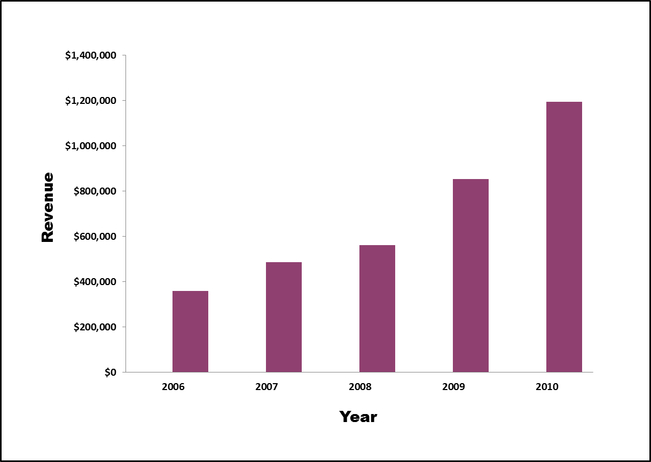
Commercial Cell Storage
Revenue by Year

Slide 25
Cell Storage Improvements
Changes for future Improvements
  Developed cost models
  Auto renewal process (eRoom)
  Standardized terms and conditions (Domestic, International)
  Developed questionnaire regarding storage
  Developed SOPs (Domestic International)
  Developed global product offering (Domestic, Inetrnational)
  Expansion on LN2 storage
  Expansion on Pharmaceutical storage capabilities
  Bring new technologies for assay development
  Automation in sample processing

Slide 26
Summary
Perspective on Biobanking
Importance of High Quality Specimen Collection, Storage and Distribution
Government Contracting Process
Commercial Storage Process

Slide 27

How Accomplished…….?
Personal touch
Dedication to service
Customer Education
Meeting and Exceeding
customer expectations

Slide 28
Thank you for Your Attention
Questions??

