Slide 1
SPQA
Senate Productivity
and Quality Awards
Marcia Harrington, PhD
Executive Director
April 10, 2019

Slide 2
Objectives
1
2
3
2
Inform
What is SPQA?
What does it do?
Describe
Baldrige Performance Excellence Framework
Solicit
Ways to get Involved

Slide 3
SPQA
501c(3)
Virtual
Baldrige Performance Excellence Program
All Volunteer
MBNQA
WORKING

Slide 4
Performance Excellence

Slide 5
SPQA Points of Entry & Life Cycle
OTW
Discovery
Award
w/Levels
Increasing Levels of Organizational Maturity

Slide 6
SPQA Services
Mentoring
Examiners
Education
Training

Slide 7
Baldrige as: (1) An Integrated Improvement System
Organizational Profile “What’s important?”
Inform
Processes “What do we do and how do we do it?”
Results “Were we Successful?
Baldrige Core Values

Slide 8
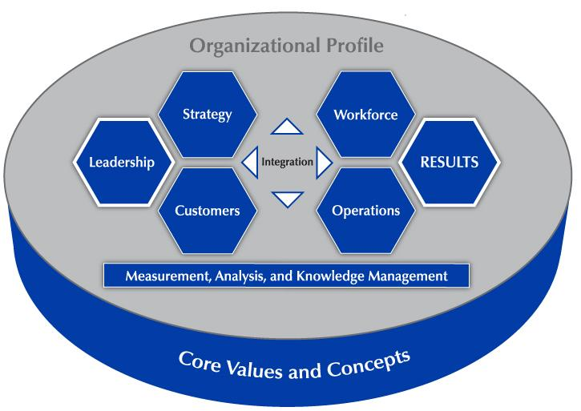
Baldrige Performance Excellence Framework

Slide 9
Journey To Excellence
Fully Aligned, Integrated, Repeatable, Measured Processes
TO
Loosely Defined Strategies , Org. Goals
Key Strategic and Operational Plans
FROM
Reactive Processes

Slide 10
Baldrige as: (2) Management System
Change initiatives
Energize improvement
Focus on common goals
Competition
Align resources

Slide 11
Value of the Journey
STRs & OFIs
Organizational Learning
Measure & Track
Facilities Improvement
Alignment & Integration
Relevant & Updated
Notes:
SLIDE 11:
Organizations that engage in the Baldrige journey to performance excellence look for the OFIs;
The feedback report Highlights Opportunities for Improvement through the lens of multiple examiners. Those OFIs
are what the organizations are paying for said one applicant.
They want to know what they could be doing better.
The Framework and the Baldrige core values
Promote alignment with organization’s strategies and goals;
Forces the organization to tracks progress on processes;
The results indicate achievement or where change is needed.
SPQA award program leads organizations through Self Assessment using the Baldrige Performance Excellence Framework.
Team of examiners (6-9) review an application and conduct a site visit, and prepare a feedback report in line with the Baldrige Criteria and Framework.

Slide 12
Marketable Results of Pursuing the Baldrige Journey
Productivity
Market Share
Customer Loyalty
Worker Relations

Slide 13
Get Involved
Learn
Criteria Training
1
2
Serve
Examiner
Host
Offer Site
3
4
Educate
Advocate
Notes:
Our Board is trained in the Criteria which is updated every two years. Examiners are trained in the criteria and in the evaluation methods required by Baldrige.
Training is conducted by our Board; and experienced members of our Board serve as mentors. training is based on the national Baldrige model which has regularly received national recognition with multiple LEAD awards, highlighted in Leadership Excellence Essential magazine and highlighted in HR.com as among the very best US and global continuing-education programs in organizational and leadership development and human resources.
We have Opportunities for individuals to work with us:
Consider serving as an Examiner. It is an intensive, rewarding learning experience and of great value to the organization that has invested in completing an application. Examiners review and score applications, participate in site visit, write feedback report, and serve as ambassadors They also gain valuable skills, knowledge, and experience.
There is no charge for Examiner training if the individual is to serve as an Examiner. Although at a cost, you may attend examiner training to just learn and not participate as an Examiner.
Or Learn about the Baldrige Criteria and the Baldrige Framework. Attend a Criteria training. Watch our website. Criteria Training is open to public 4 times per year.
Or Consider Hosting a Criteria training at your organization for your team. We can work with you.
Or contact me if you have other ideas. We have opportunities for marketing and technology among other areas.

Slide 14
Marcia.Harrington@spqa-va.org
Executive.Director@spqa-va.org
540-312-5393
SPQA-VA.org
Notes:
Slide 14

